Slide 1
Bryant Ave S Reconstruction
Stakeholders meeting #1
April 6th , 2023

Slide 2
Meeting Agenda
Introduction & Welcome
Purpose of this meeting
    Project recap and construction update:
      Provide a brief recap of the project background & Phasing
      Project scope
      Provide information regarding construction
  Discussion:
    Phase I
      What we have heard
    Phase II modified design
  Process and moving forward
    Evaluate phase I
    Community meeting(s)
  Questions

Slide 3
Question and Answer Instructions
You can write your question on the chat box
You can raise your hand

Slide 4
Project Recap

Slide 5
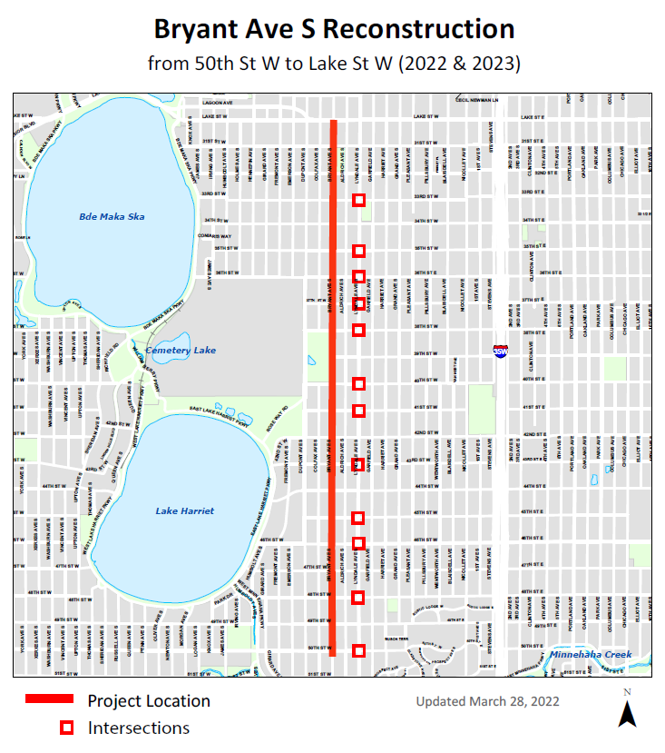
Project Location
Bryant Aves S,
from 50th to Lake St W (2.5 miles)
Lyndale intersections
from 50th – 33rd St W

Slide 6
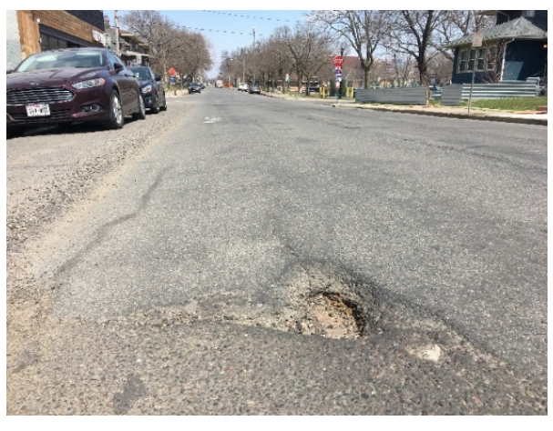
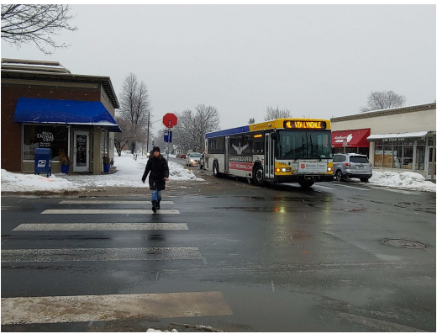
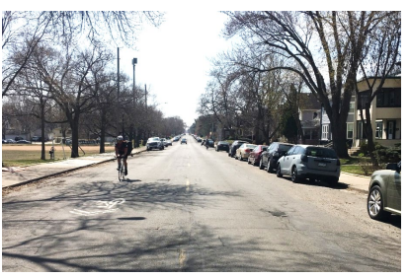
Existing Conditions
People use the street in different ways
60-year-old infrastructure

Slide 7
General Project Scope (2023)
Bryant scope of work includes:
  New roadway w/ Curb and Gutter
  New ADA ramps
  New sidewalks
  Off street bikeway
  Utility Improvements (Sanitary, Storm and Water)
  Landscape – Boulevard and Trees
  Green Infrastructure
  Street Lighting
  Signal improvements :- @ 36th , 35th, 31st and Lake St W

Slide 8
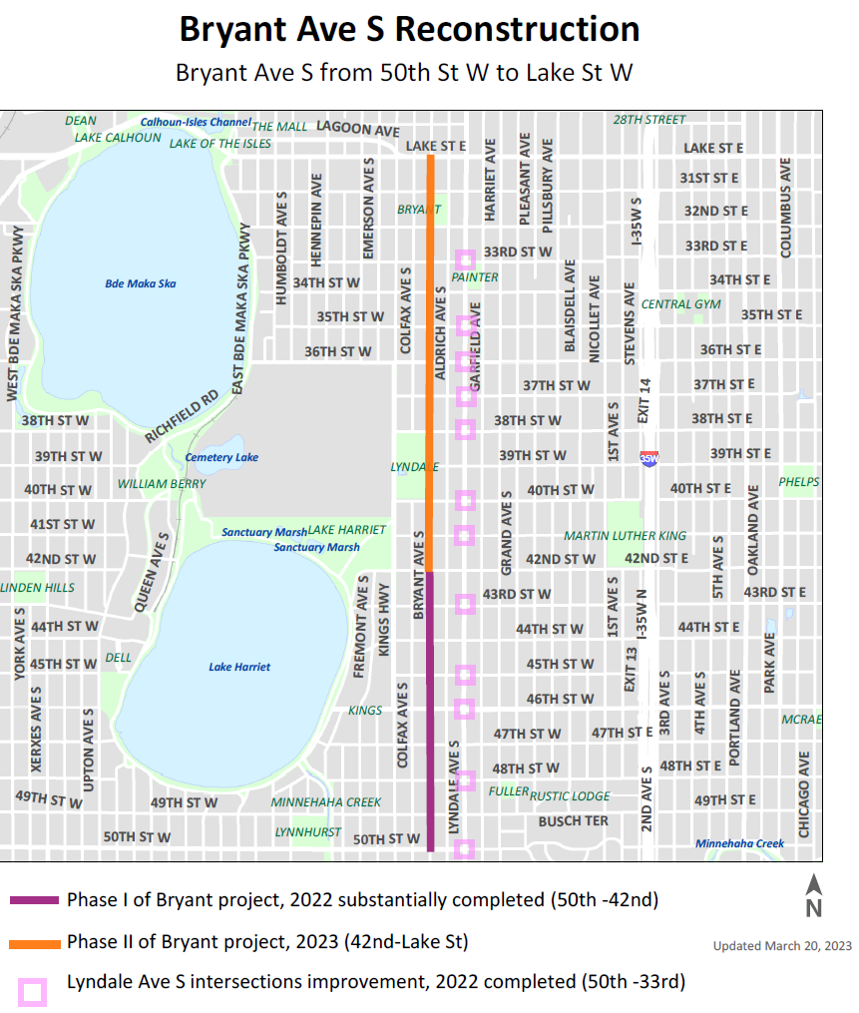
Construction staging
2022
Substantially completed
Lyndale intersections
Bryant (50th – 42nd St W)
2023
Bryant Ave S (42nd – Lake St W)
  Stage 2A Bryant (42nd – 35th St W)
  Stage 2B Bryant (35th – Lake St W)
Stage 2A construction start April 10th 2023.

Slide 9
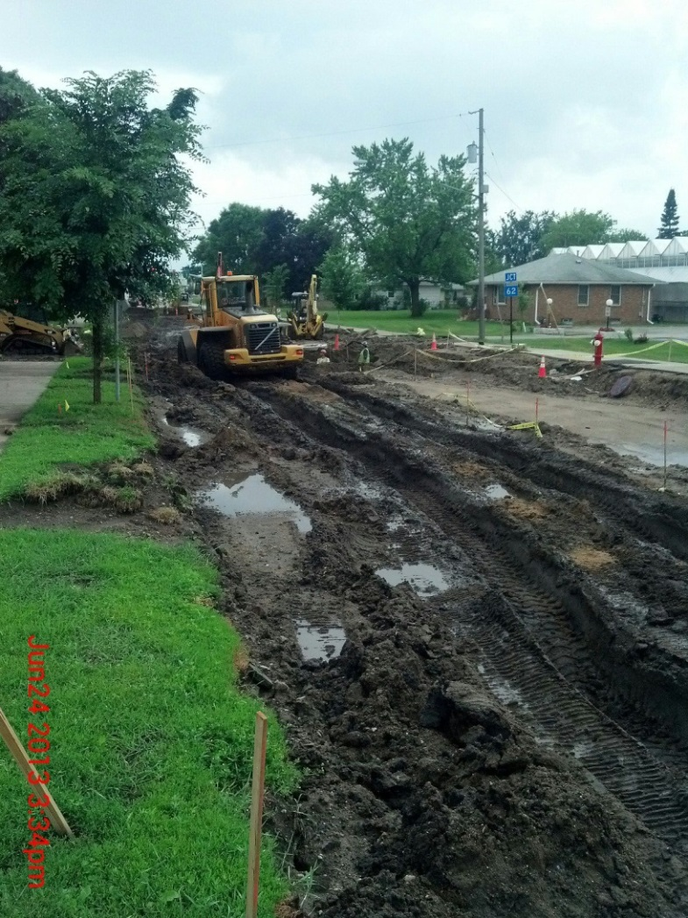
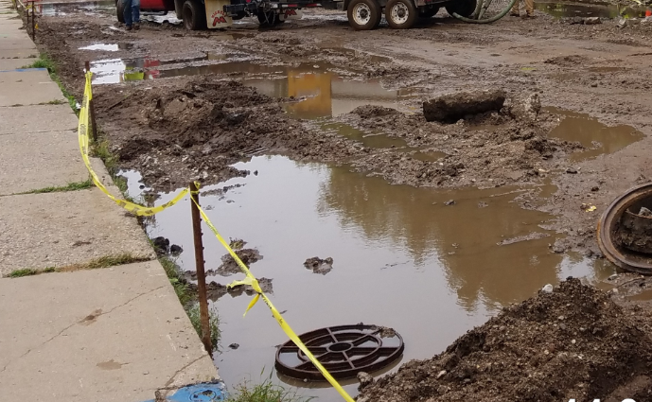
Reasons for schedule change
Weather
Underground surprises
Check project web site
Signup to receive project newsletter

Slide 10
Coordinated work
CenterPoint:- Abandoned pipe gas removal along Bryant
Xcel Energy:- Relocation and removal of existing power poles
Verizon/MCI:- Adjustments/relocation of existing structures
Lumen:- Adjustments/relocation of existing structures, installation of new conduit to accommodate proposed construction.
USI:- Adjustments/relocation of existing structures, installation of handholes to accommodate proposed construction.
Minneapolis Park Board (new trees)

Slide 11
Encroachments
Private property in the boulevard may be impacted by the project, examples include:
  Sprinkler Systems
  Decorative Pavers
  Flowers
  Other special items in the Right-of-Way ( 2- 4’ behind the sidewalk)
Please relocate these items from the construction area before the project starts.

Slide 12
Private Services
If you’ve been experiencing sanitary or water service lines issues or if you would like to upgrade/replace your connection please consider to coordinate with the project as soon as possible.

Slide 13
What to expect during construction

Slide 14
Construction Notes
During the majority of construction, local access to home and business will be maintained. However, there will be times that will be difficult to access into and out of the area.
    We’ll work with you on individual access into your property.
During driveway apron placement, there won’t be access for about 10 days.
  We will notify in advance and coordinate with individual property owner
Bus Detour:-Metro Transit website will have most current update. http://www.metrotransit.org/
Typical work hours to be Monday to Friday, 7am to 6pm but the contractor will work up to 8 pm for majority of time.

Slide 15
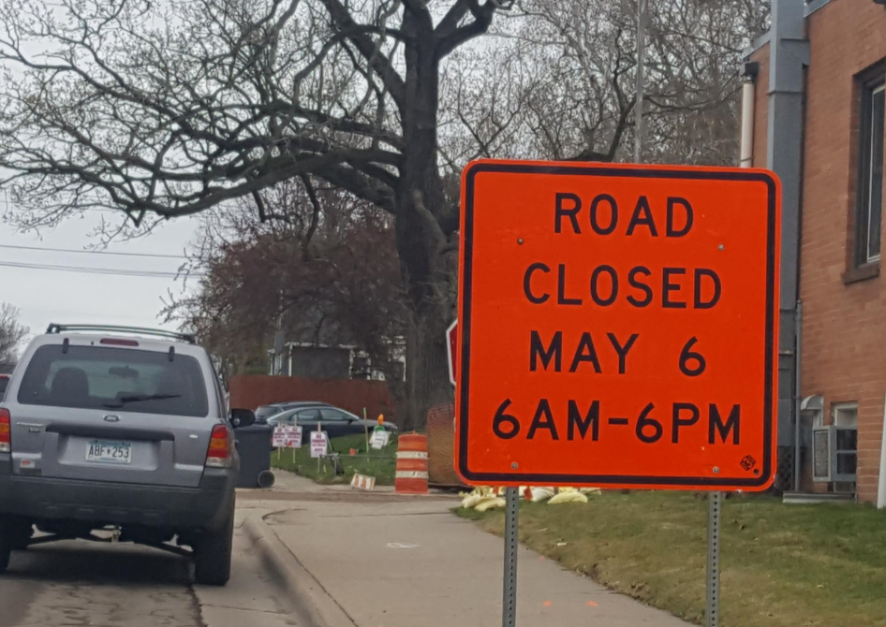
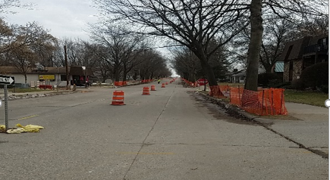
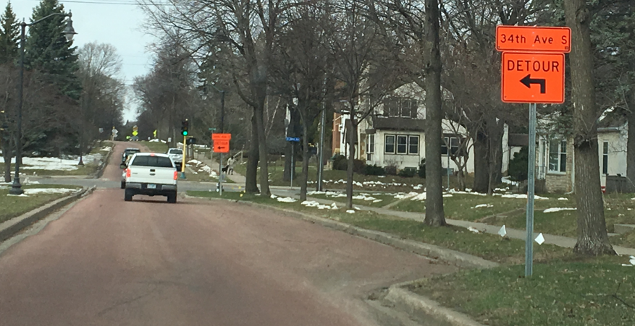
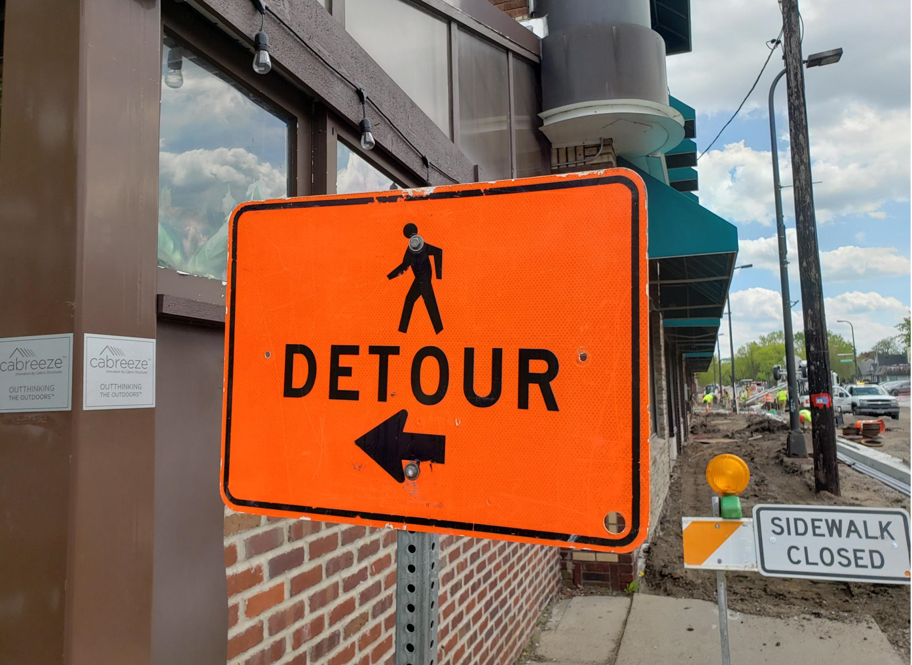
Traffic Control set up

Slide 16
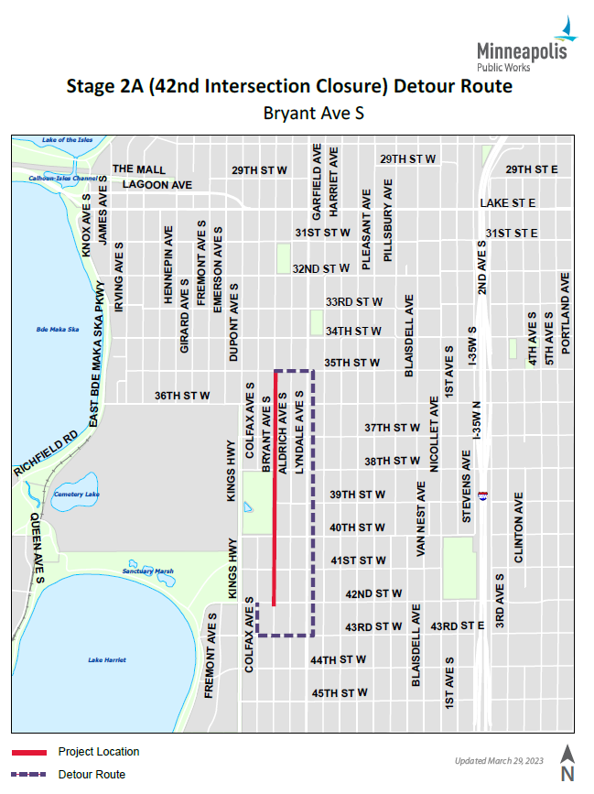
Stage 2A Detour

Slide 17
Next steps
We will have weekly stakeholder meeting to provide project progress and answer if there is any question or concern (the link will be posted on the project web site,
  https://www.minneapolismn.gov/government/projects/bryant-ave-s-reconstruction/ )
Weekly construction newsletter will be sent for email subscriber.
Intermittent newsletter will be sent as needed.
Please visit the project website to sign-up for the project newsletter.

Slide 18
Contact Info
Project Manager: Menbere Wodajo
612-900-5848 or Menbere.wodajo@minneapolismn.gov
Chief Field Inspector: Drew Torgerson
612-280- 4359 or andrew.torgerson@minneapolismn.gov
Project webpage:
https://www.minneapolismn.gov/government/projects/bryant-ave-s-reconstruction/

Slide 19
Phase I Challenges

Slide 20
Bryant Ave Phase I (50th -42nd St W)
Feedback and Challenges
Emergency vehicle access
Snow plowing operations
Ability to get in/out of driveways
Ability to get in/out of parked vehicles

Slide 21
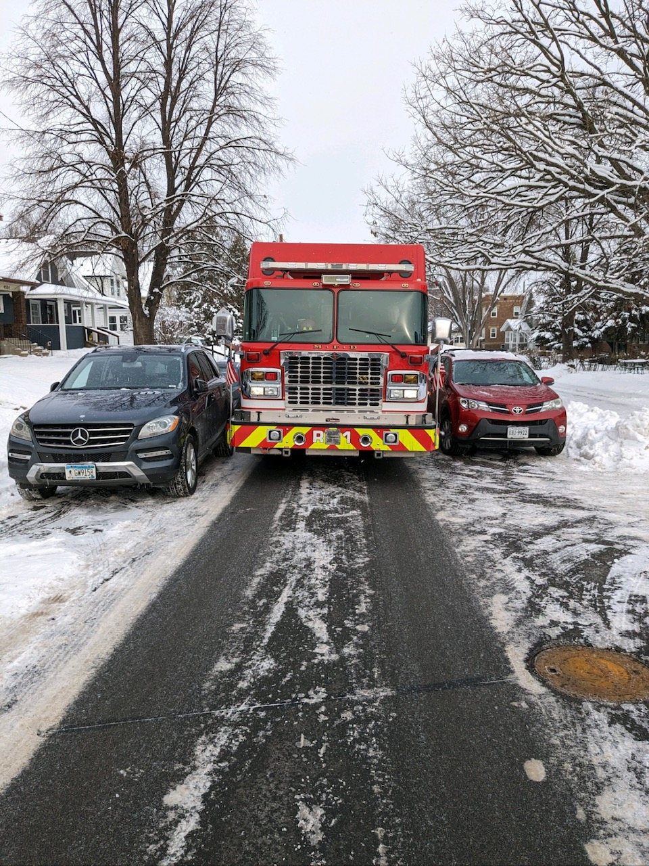
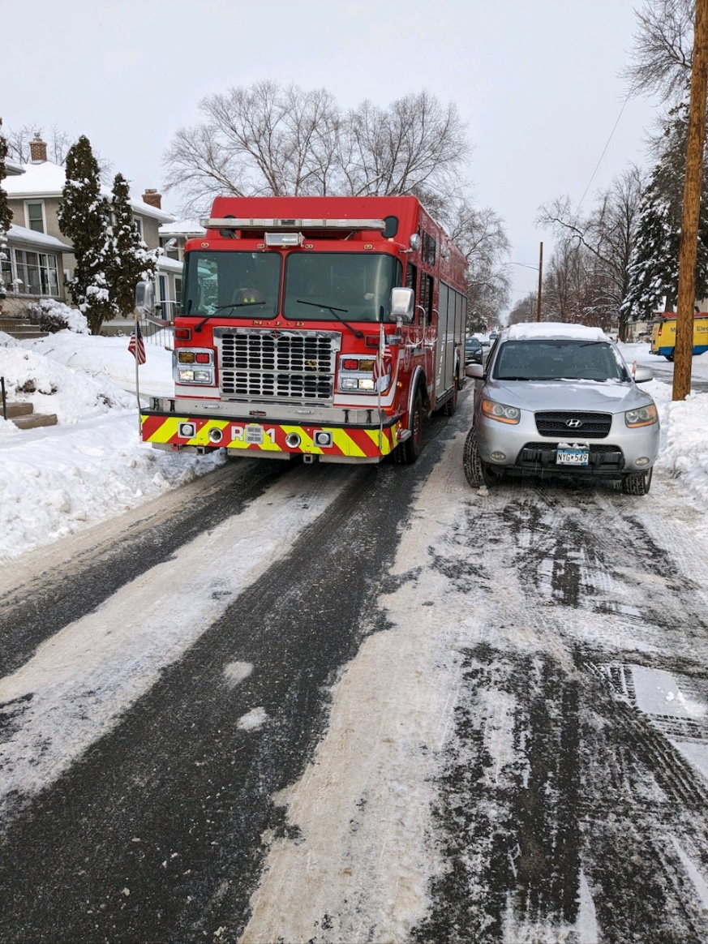
Fire truck

Slide 22
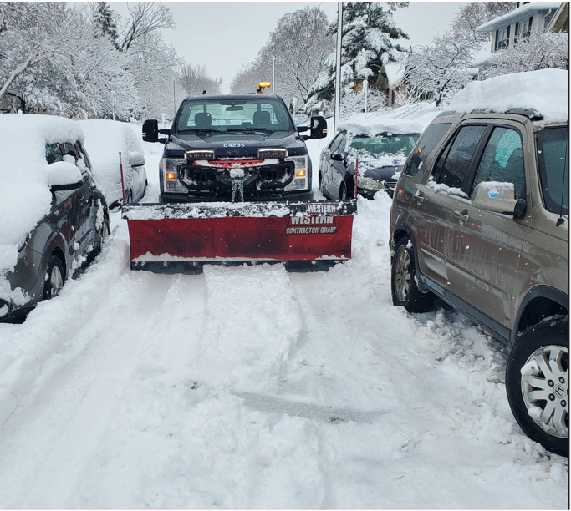
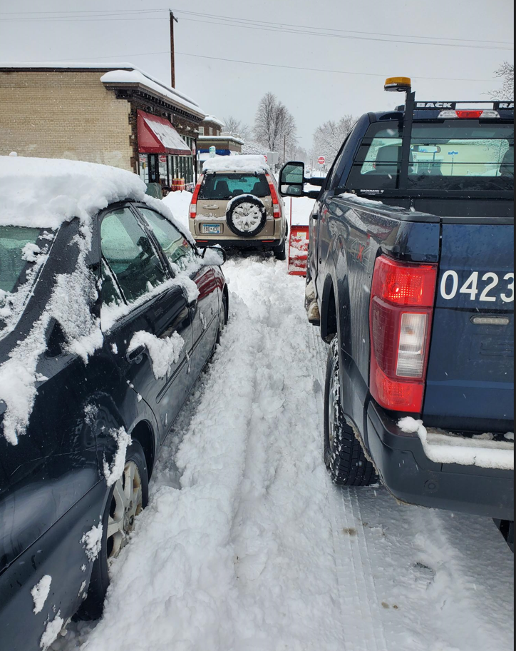
Snow plowing

Slide 23
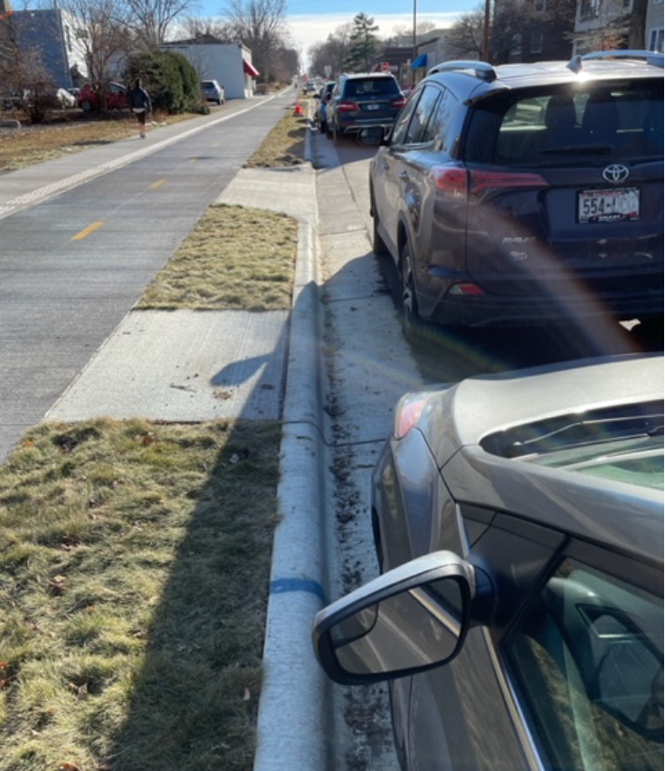
Left or Driver’s side parking

Slide 24
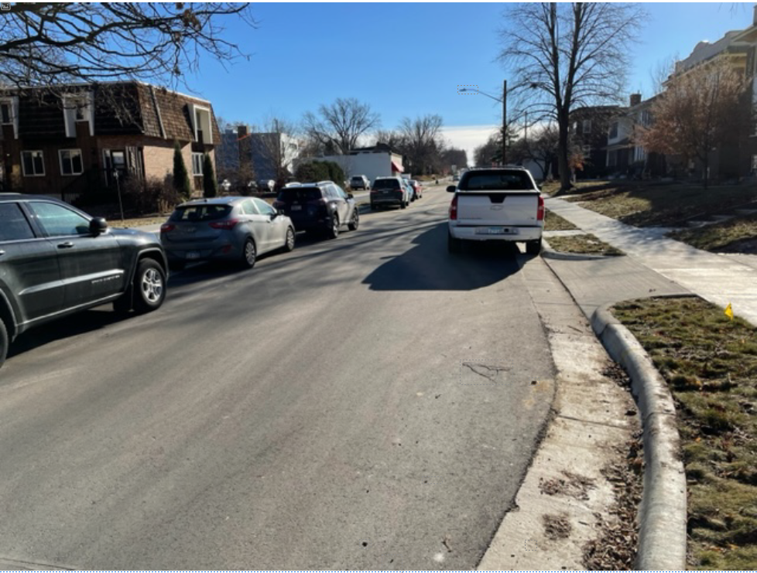
Driveway access

Slide 25
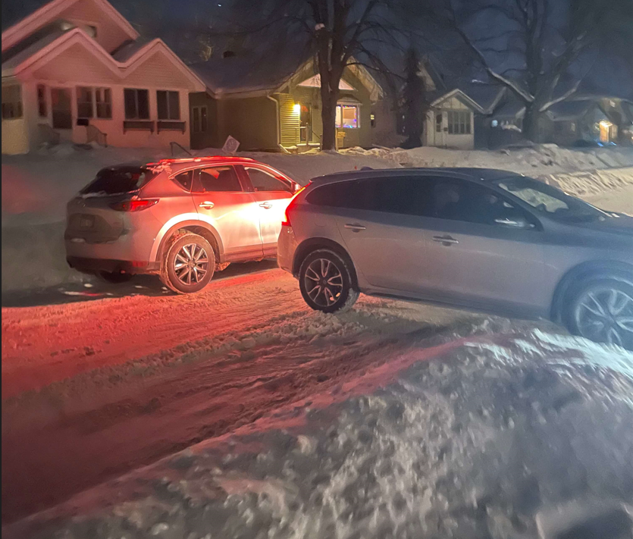
Driveway access

Slide 26
Phase II Design Modifications

Slide 27
Original Design Cross Section (41st - 42nd)

Slide 28
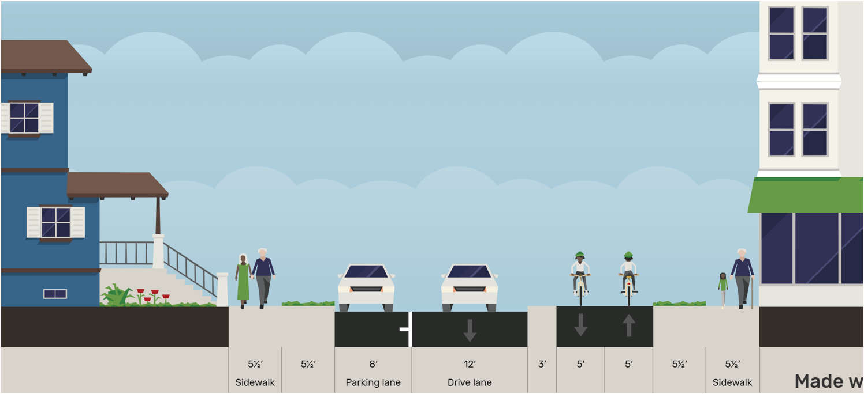
Bryant Ave Phase II
Revised Design (41st – 42nd)

Slide 29
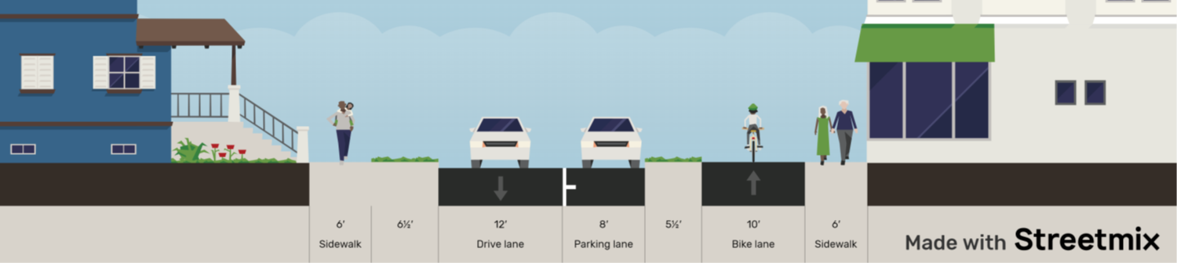

Original Design (41st – 42nd)
Revised Design (41st – 42nd)

Slide 30
Bryant Ave Phase II
Revised Design Summary
Maintain designated pedestrian and bicycle space along the corridor
Maintain the protected bicycle facility design at sidewalk level
  Buffer between street and bikeway
Maintain traffic calming and safety elements
  Narrowed travel lanes
  Mid-block as either chicanes or bumpouts
  Intersection bumpouts
  Additional bumpouts near some intersections
Adjust the location of the boulevard green space
Adjust curb lines as needed
Widen driveway aprons
Parking on the right or passenger side only

Slide 31
Bryant Ave Phase II
Original Design (41st – 42nd)

Slide 32
Bryant Ave Phase II
Revised Design (41st – 42nd)

Slide 33
Original Design (41st – 42nd)
Revised Design (41st – 42nd)

Slide 34
Process and Moving Forward

