Slide 1
Hennepin South Reconstruction
Construction Kick-Off
August 15, 2023

Slide 2
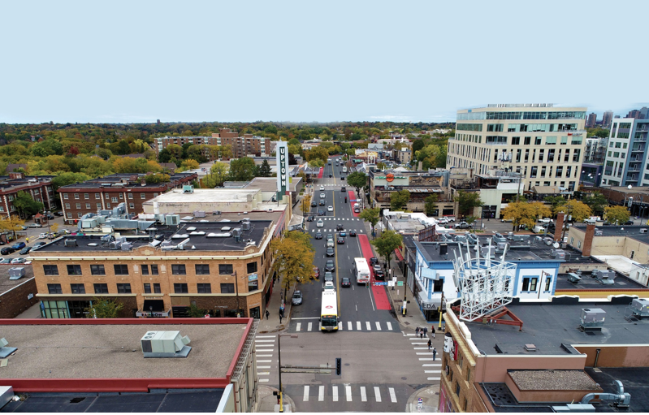
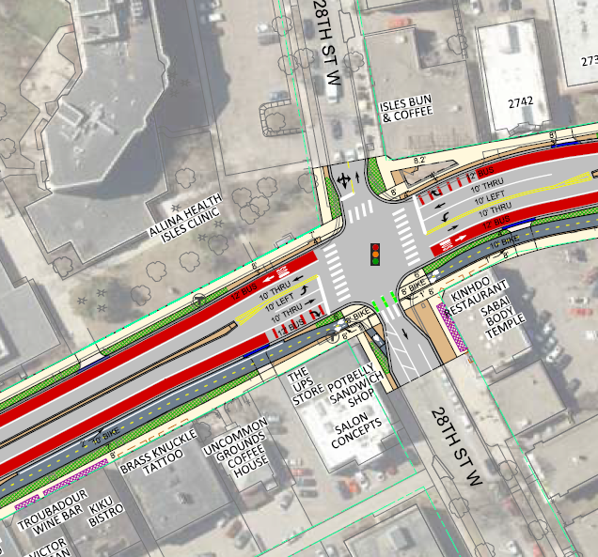
Today’s Agenda
Project Summary
  Scope
  Schedule
Construction
  Utilities
  Roadway
    Detours
What to Expect
Next Steps & Communications

Slide 3
Roadway Design
Roadway and Utility reconstruction
  Bldg to bldg or full ROW width
  Sanitary & Storm Replacement
  CenterPoint Gas Main Replacement
  Xcel Energy Upgrades
  Signals and Lighting
Two-way sidewalk level bikeway on east side
2 transit priority lanes
2 vehicle lanes
  Left-turn lanes at key locations
Additional vehicle lanes provided at end points where capacity is needed
Parking/loading bays

Slide 4
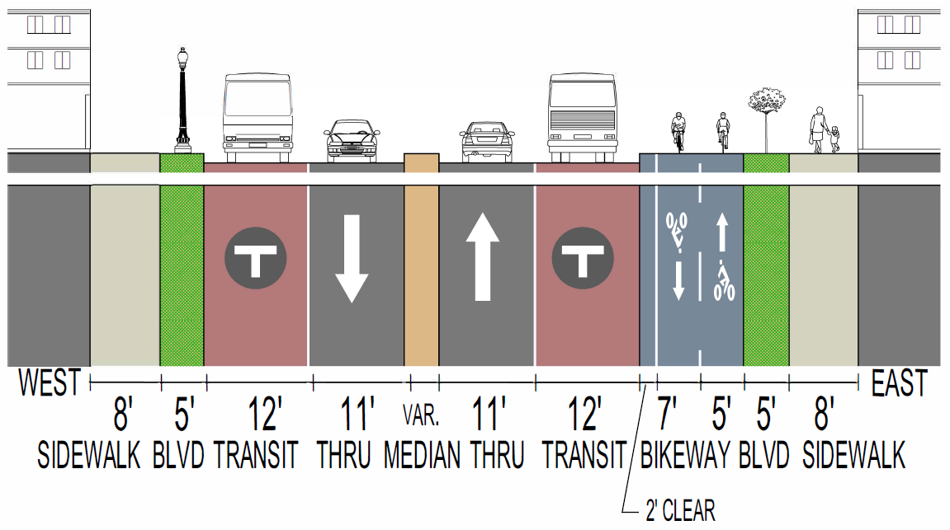
General Cross-Section

Slide 5
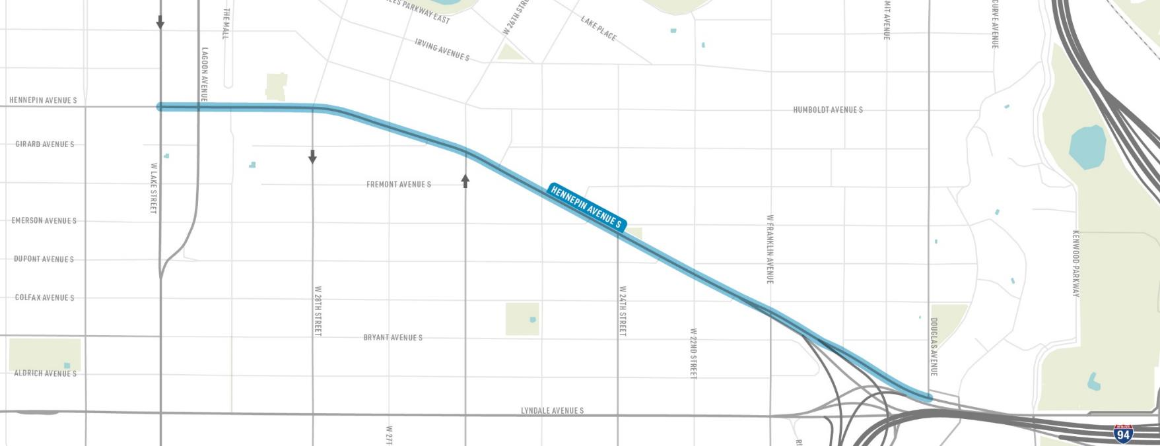

Hennepin Avenue Reconstruction from Lake St to Douglas Ave
N
EAST ISLES
LOWRY HILL
W LAKE STREET
HENNEPIN AVENUE
FRANKLIN AVENUE
W 26TH STREET
W 28TH STREET
DOUGLAS AVENUE
LOWRY HILL EAST
Downtown →

Slide 6
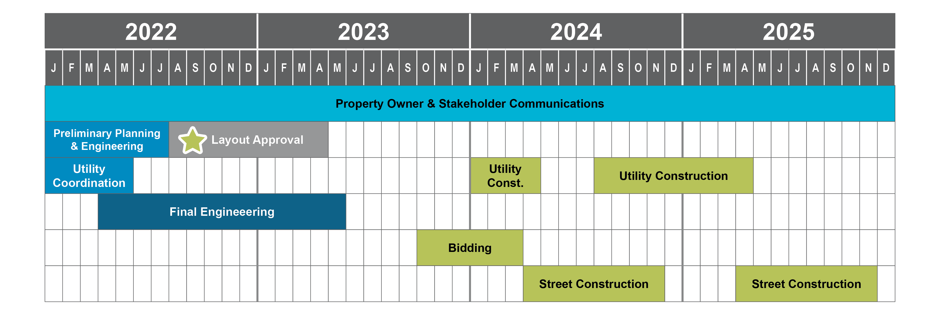
Schedule
WE ARE HERE
Utility Construction

Slide 7
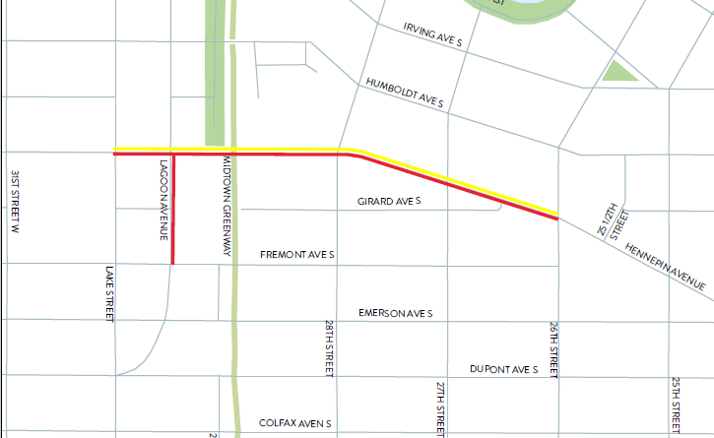
Utility work PHASE 1 – 2023/2024 = Lake St to W 26th St.
Hennepin - CenterPoint Gas 2023
  Starts 9/4 thru 12/1
Lagoon – Xcel Energy Upgrades 2023
  Starts 9/4 thru 1/1
Hennepin - Xcel Energy Upgrades 2024
  Starts 1/1 thru 4/15
Lane Closures and Parking Restrictions

Slide 8
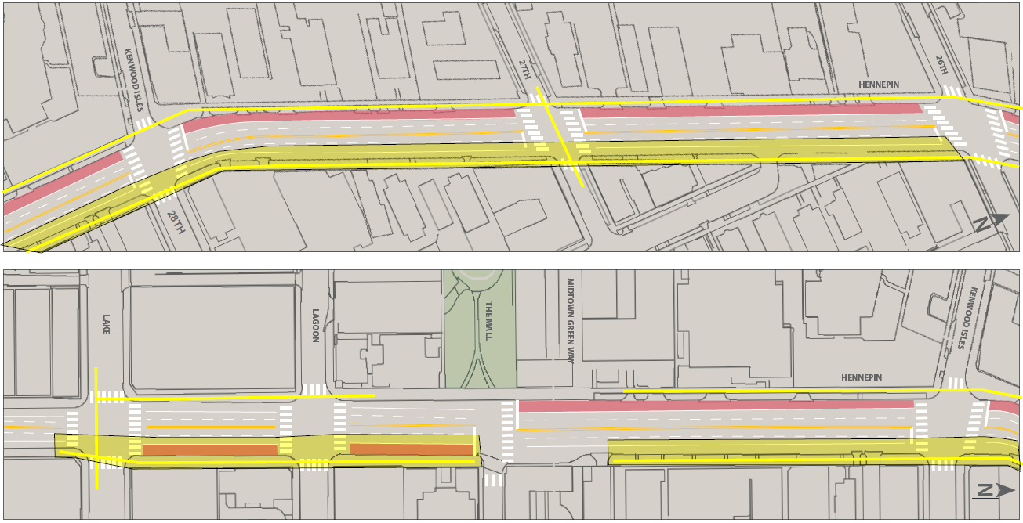
Utility work PHASE 1 – 2023/2024 = Lake St to W 26th St.

Slide 9
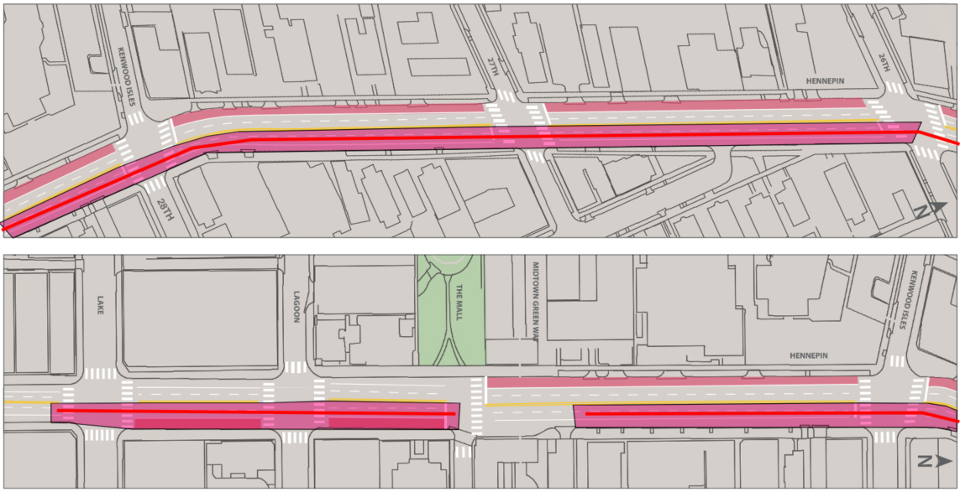
Utility work PHASE 1 – 2023/2024 = Lake St to W 26th St.

Slide 10
Roadway PHASE 1 - 2024 = Lake St to W 26th St.
N
HENNEPIN AVENUE
W LAKE STREET
W 28TH STREET
W 26TH STREET
Downtown →

Slide 11
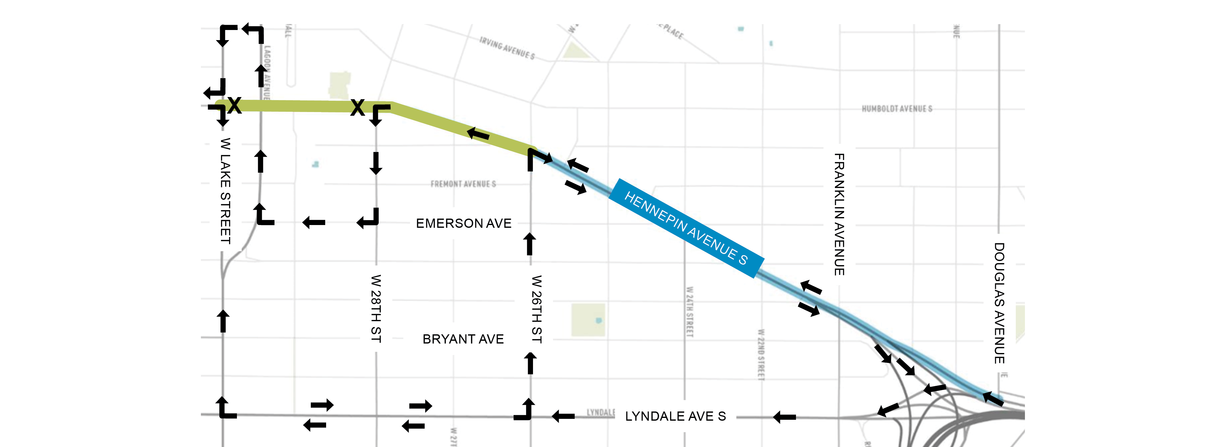
Staging: Phase 1 - 2024
N
** Work Zones, Lanes Configuration, and Access Subject to Change
I-94 INTERCHANGE
Downtown →

Slide 12
PHASE 2 – 2025 = W 26th St. to Douglas Ave
N
HENNEPIN AVENUE
FRANKLIN AVENUE
DOUGLAS AVENUE
W 26TH STREET
Downtown →

Slide 13
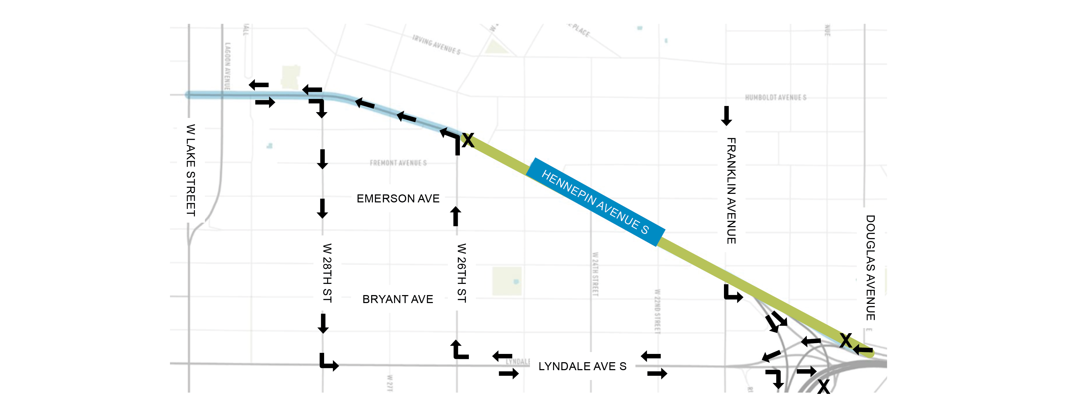
Staging: Phase 2 - 2025
N
** Work Zones, Lanes Configuration, and Access Subject to Change
I-94 INTERCHANGE
Downtown →

Slide 14
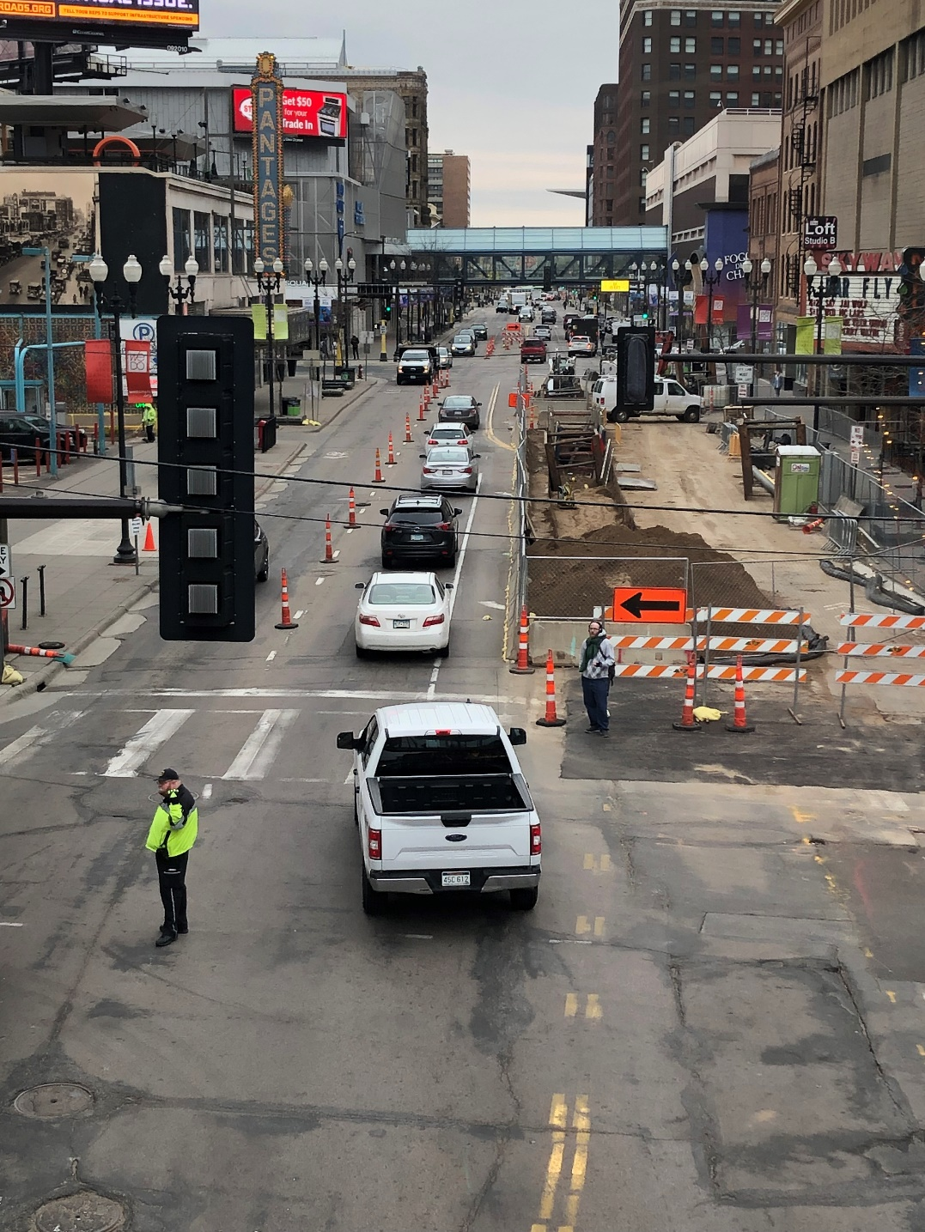
What to Expect in 2024
Disruption
Noise
Dust
Pedestrian Detours
Traffic Impacts
  Lane Closures
  Parking Closures
  Lane shifts
  Single Lane operations
** Work Zones, Lanes Configuration, and Access Subject to Change

Slide 15
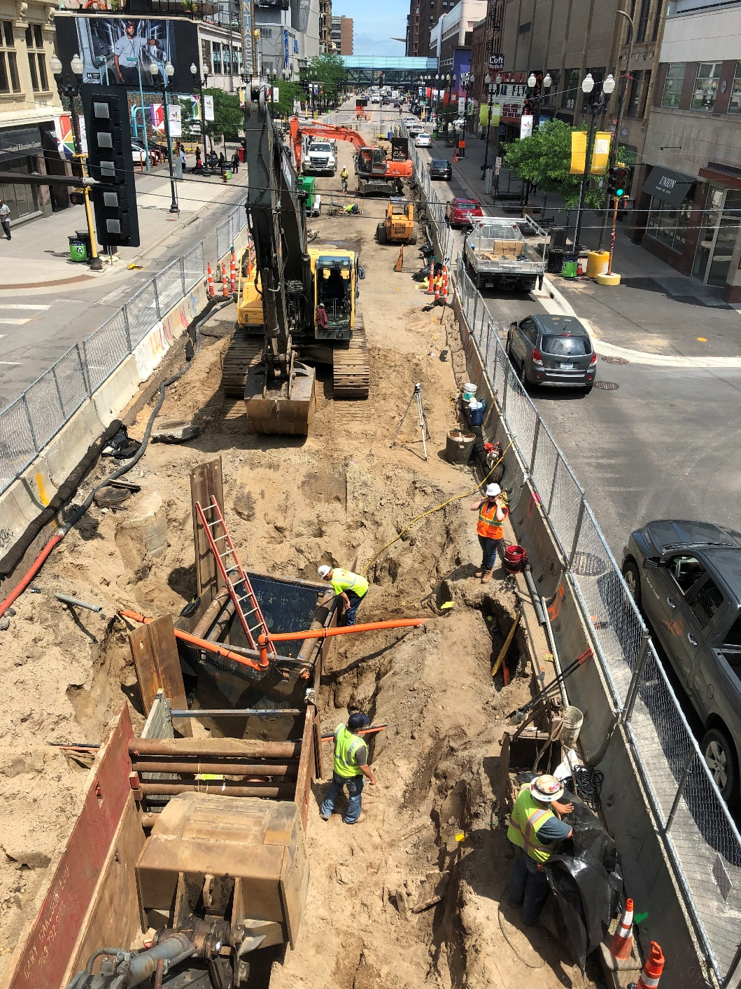
What to Expect
Sidewalks open
Business Access
  At all times
** Work Zones, Lanes Configuration, and Access Subject to Change

Slide 16
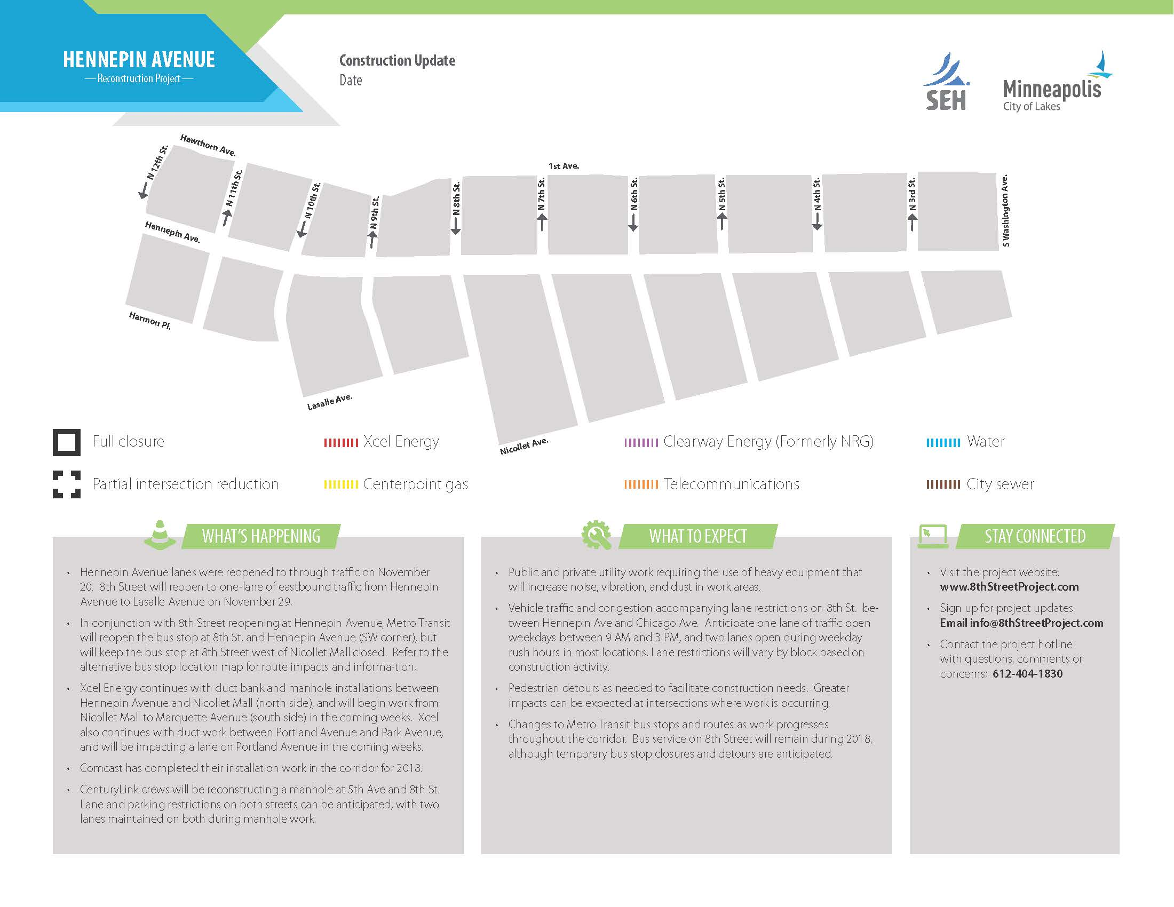
Stakeholder Communications
Weekly Email Updates
Weekly Friday Morning Mtgs
One-on-one Site Mtgs
Website
  www.minneapolismn.gov/government/projects/hennepin-ave-s/

Slide 17
Stay Connected
Questions & Answers
Website
  www.minneapolismn.gov/government/projects/hennepin-ave-s/

