Slide 1
Hennepin South Reconstruction
Construction Update
October 19, 2023, 6pm

Slide 2
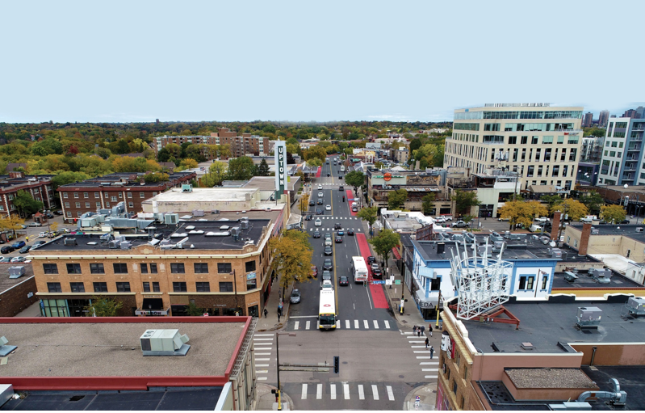
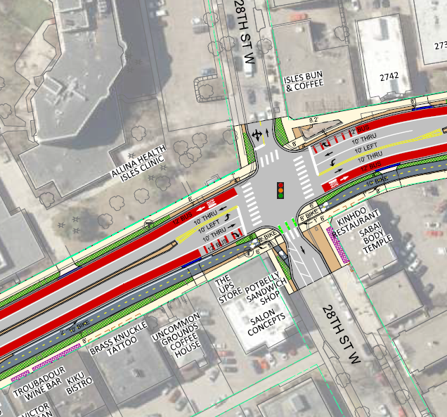
Today’s Agenda
Construction
  Utilities
  Roadway
    Detours
What to Expect
Next Steps & Communications

Slide 3
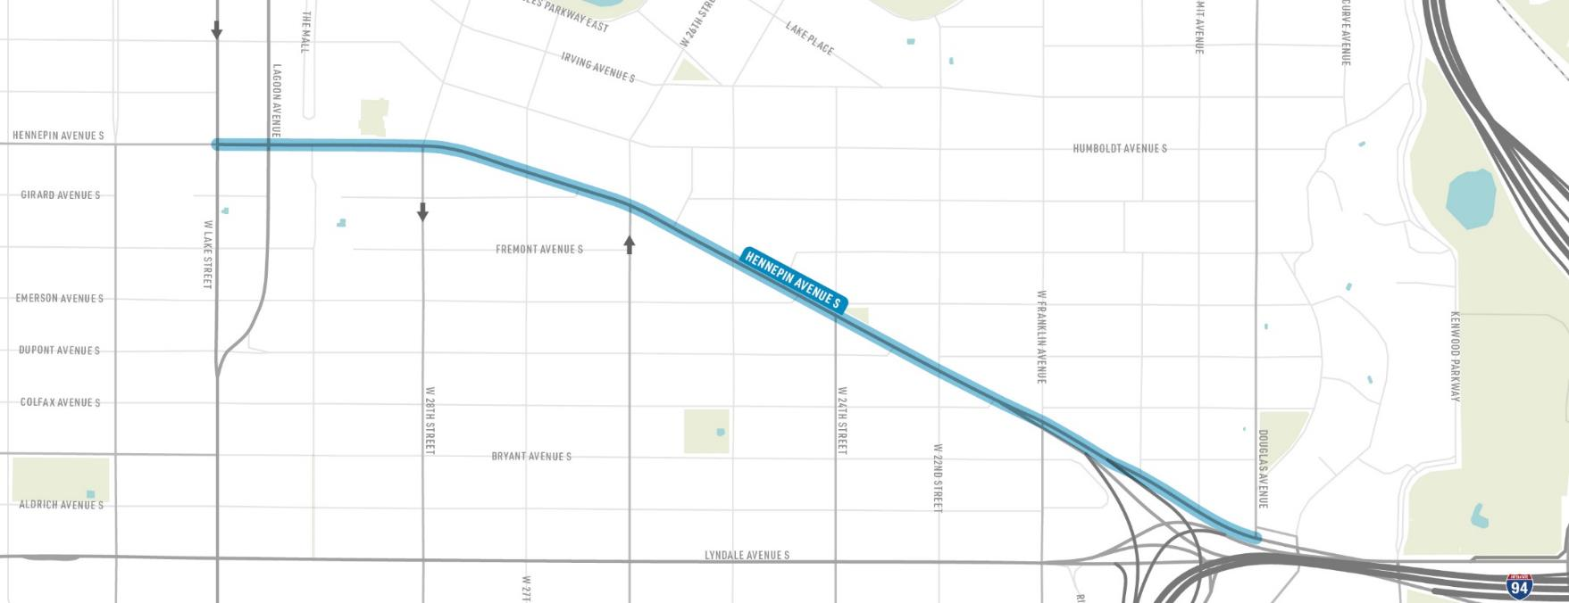

Hennepin Avenue Reconstruction from Lake St to Douglas Ave
N
EAST ISLES
LOWRY HILL
W LAKE STREET
HENNEPIN AVENUE
FRANKLIN AVENUE
W 26TH STREET
W 28TH STREET
DOUGLAS AVENUE
LOWRY HILL EAST
Downtown →

Slide 4
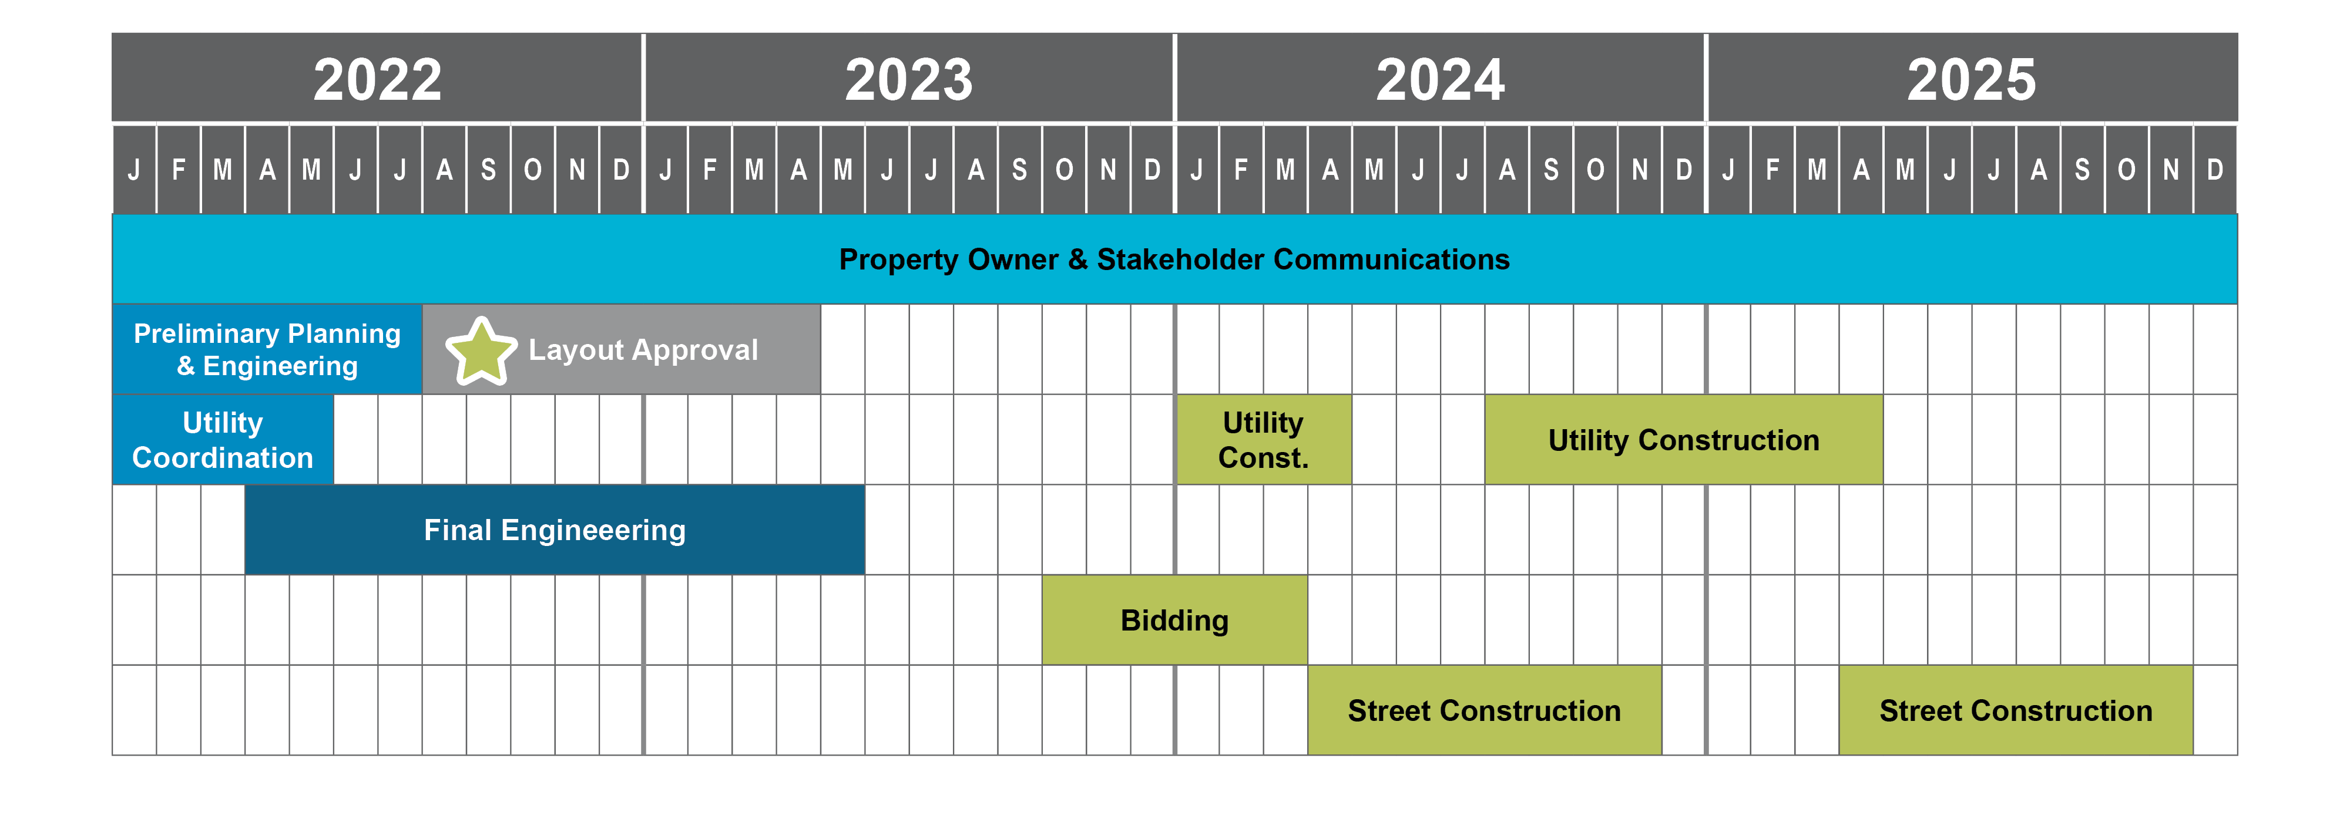
Schedule
WE ARE HERE
Utility Construction

Slide 5
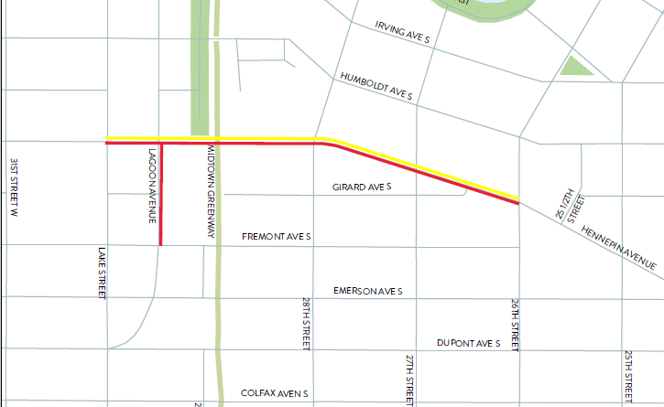
Utility work PHASE 1 – 2023/2024 = Lake St to W 26th St.
Hennepin - CenterPoint Gas 2023
  thru 11/24
Lagoon – Xcel Energy Upgrades 2023
  thru 1/1
Hennepin - Xcel Energy Upgrades 2024
  Starts 1/1 thru 4/15
Lane Closures and Parking Restrictions

Slide 6
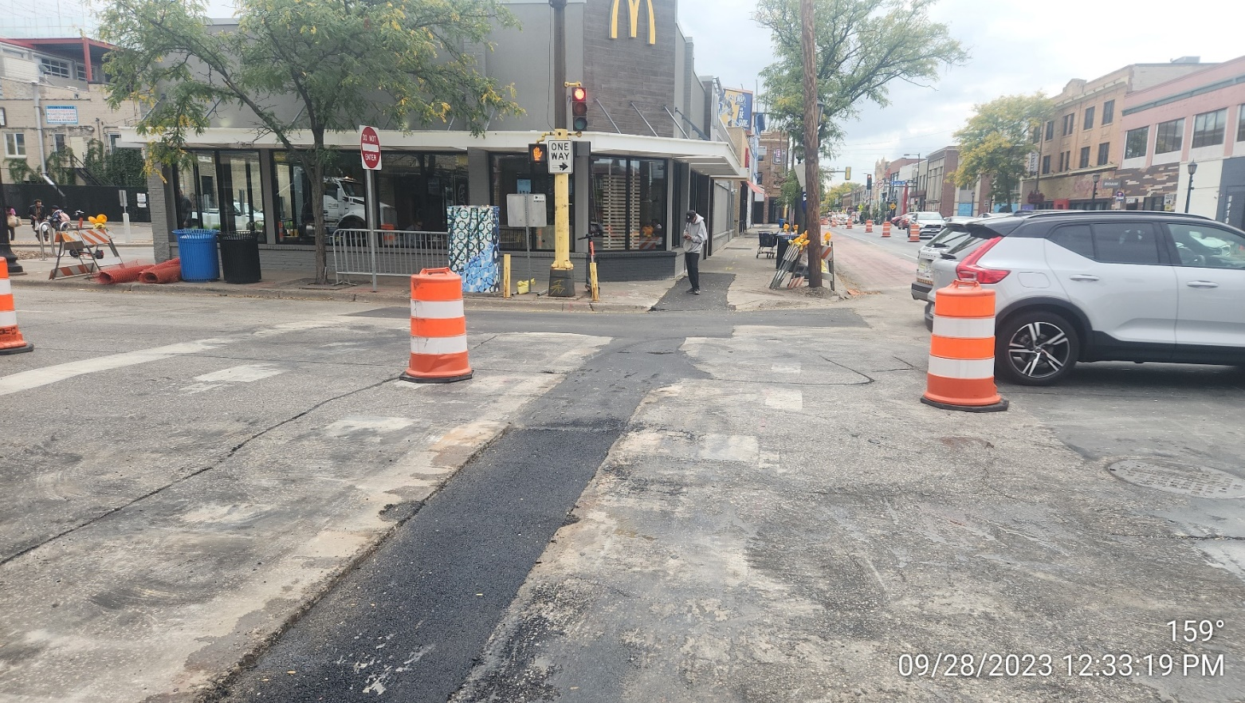
CenterPoint Energy Work
New Gas Mains on both sides
Under sidewalks
Service Connections
CenterPoint Energy - Links
  Minneapolis - Uptown (centerpointenergy.com)
  Hennepin Ave. closed (Lake St. to 31st St.) until Oct. 17 (govdelivery.com)

Slide 7
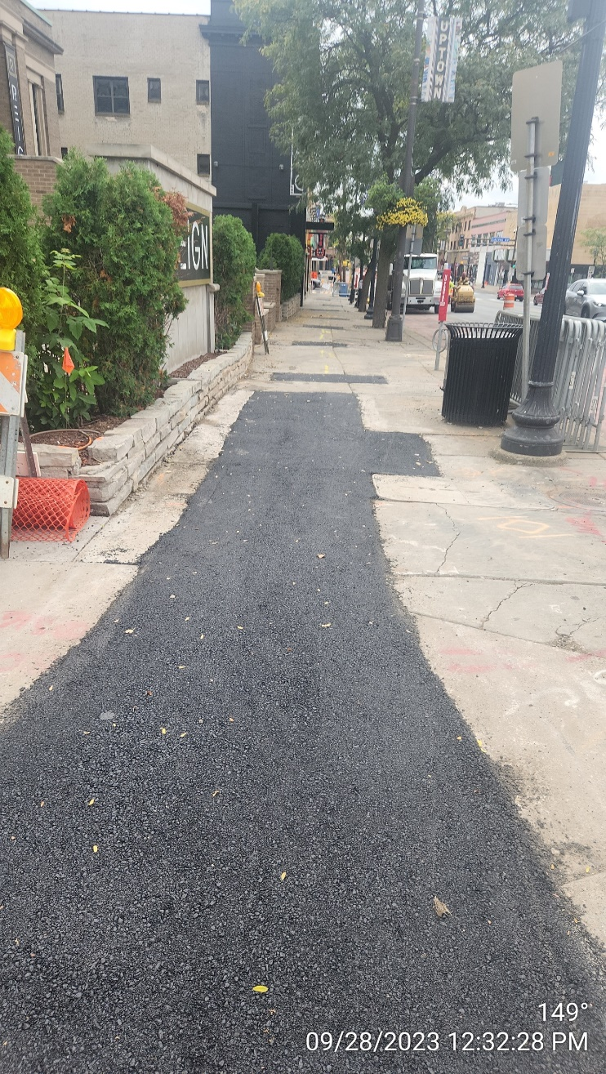
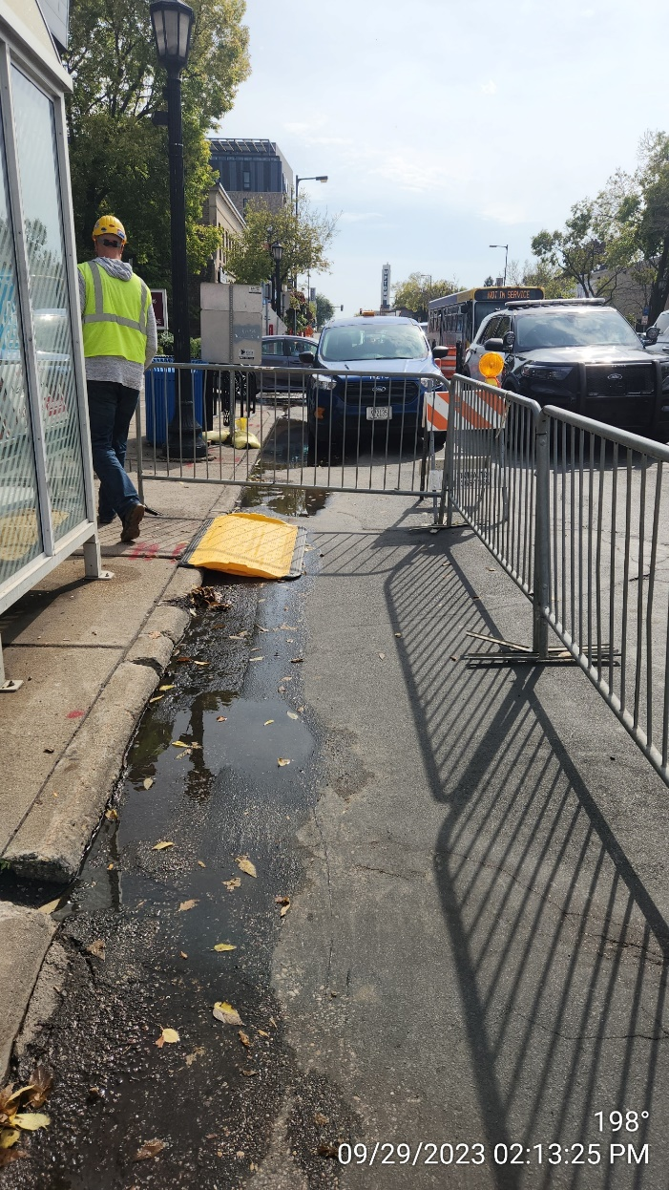
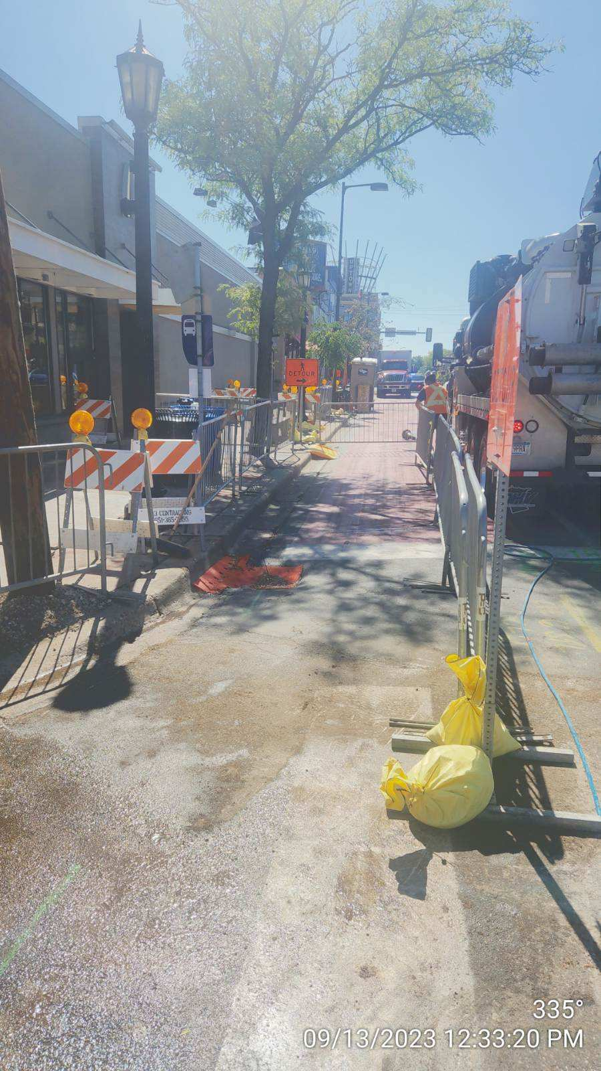
CenterPoint Energy Work

Slide 8
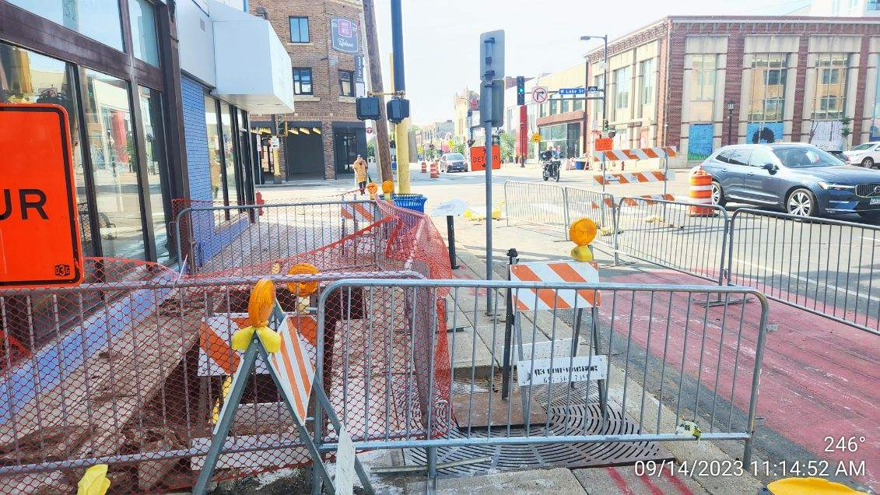
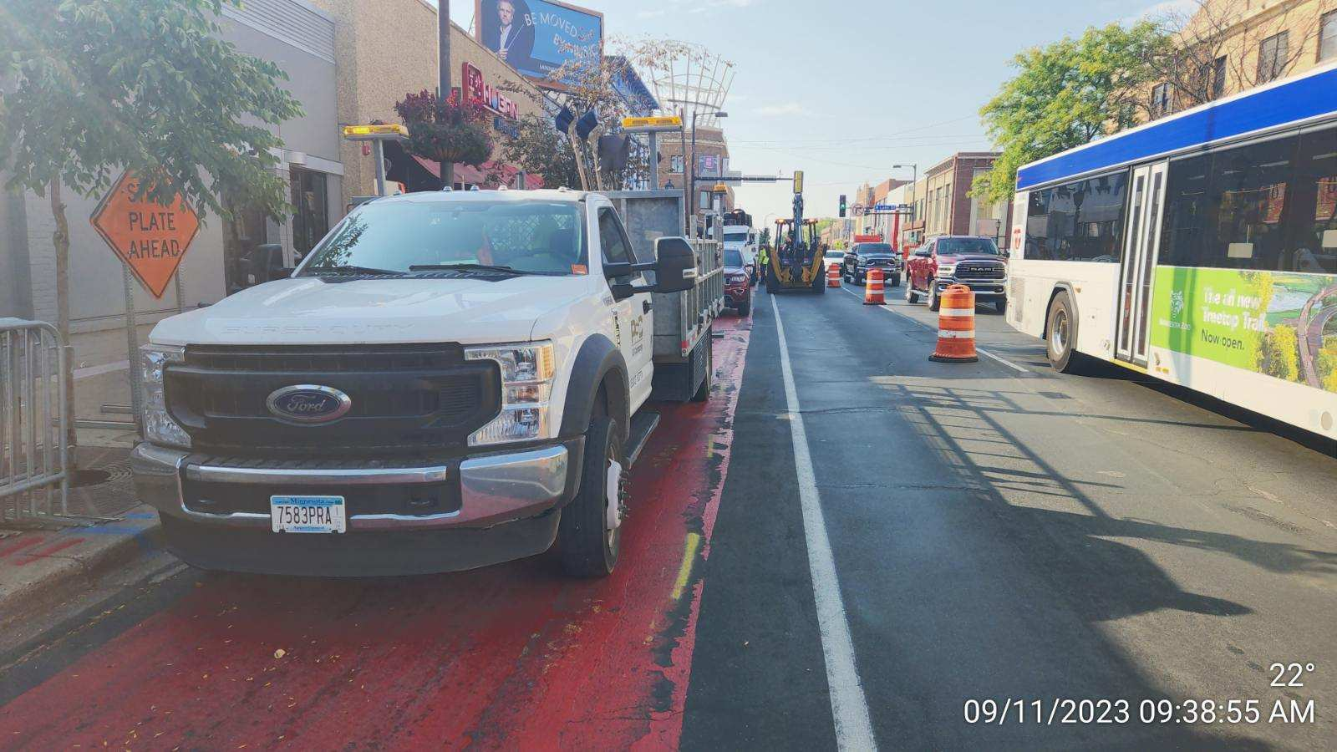
CenterPoint Energy Work

Slide 9
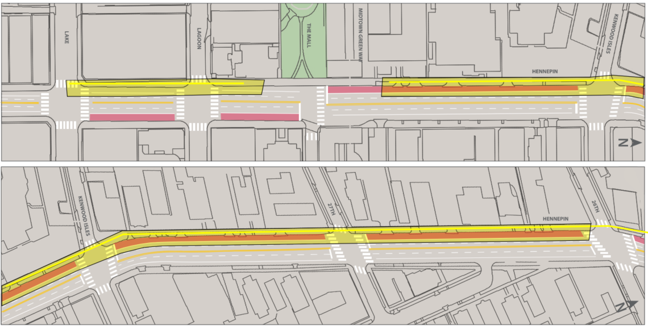
Utility work PHASE 1 – 2023 CenterPoint = Lake St to W 26th St.

Slide 10
Utility work PHASE 1 – 2023/2024 = Lake St to W 26th St.
Hennepin - CenterPoint Gas 2023
  thru 12/1
Lagoon – Xcel Energy Upgrades 2023
  thru 1/1
Hennepin - Xcel Energy Upgrades 2024
  Starts 1/1 thru 4/15
Lane Closures and Parking Restrictions

Slide 11
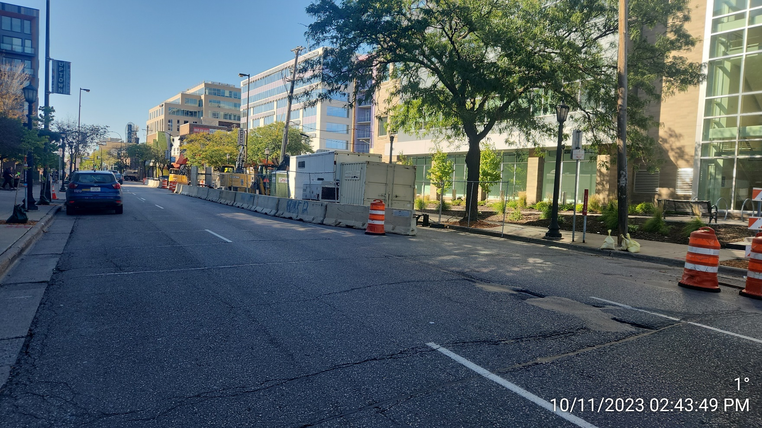
Xcel Energy Work
New Ductbank and Manholes
East side of Hennepin
Lagoon Work

Slide 12
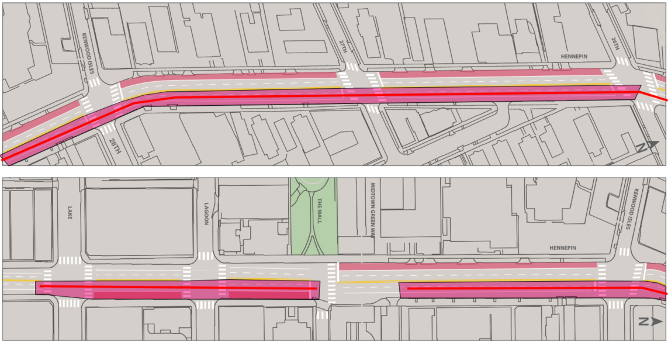
Utility work PHASE 1 – 2023/2024 = Lake St to W 26th St.

Slide 13
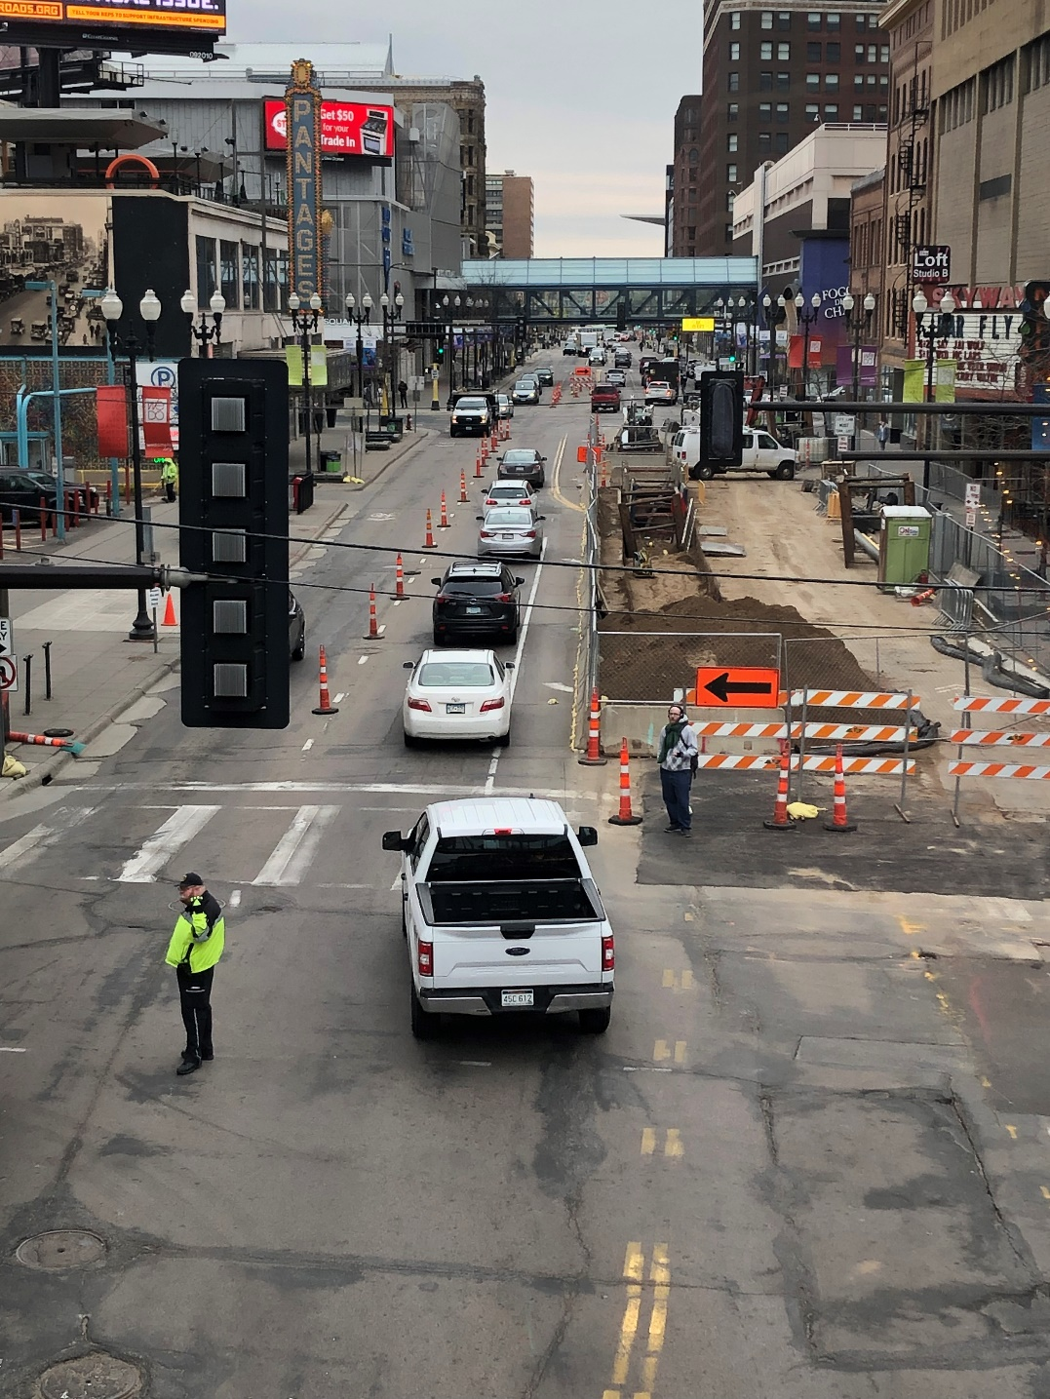
What to Expect in 2023/2024
Disruption
Noise
Dust
Pedestrian Detours
Traffic Impacts
  Lane Closures
  Parking Closures
  Lane shifts
  Single Lane operations
** Work Zones, Lanes Configuration, and Access Subject to Change

Slide 14
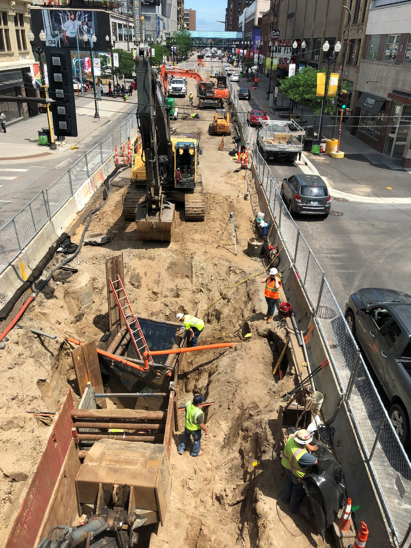
What to Expect
Lead Water Service Line Replacement Program
Sidewalks open (when possible)
Business Access
  At all times
** Work Zones, Lanes Configuration, and Access Subject to Change

Slide 15
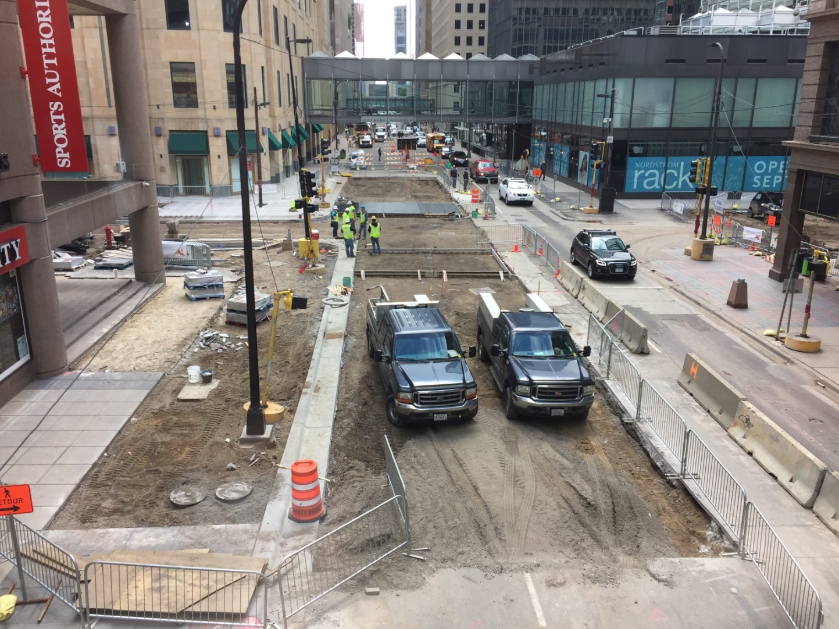
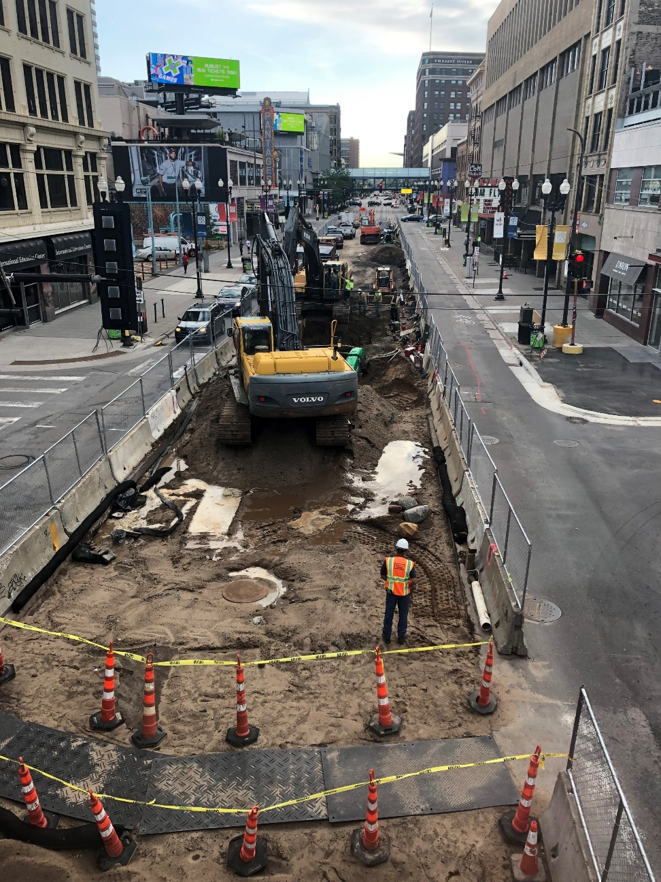
Looking Ahead – Spring 2024 Roadway Construction
Disruption, Noise, Dust, Pedestrian Detours, Traffic Impacts

Slide 16
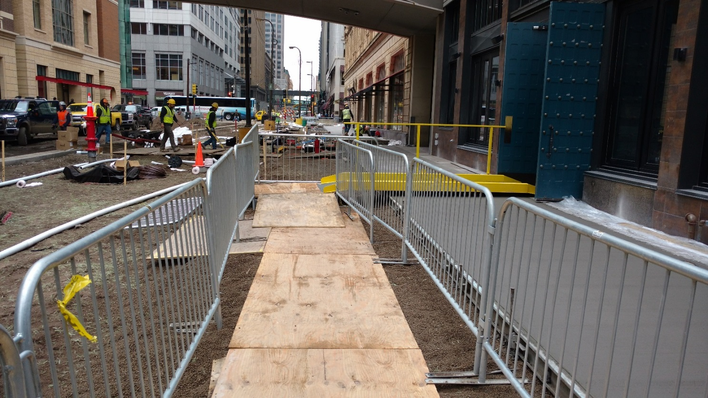
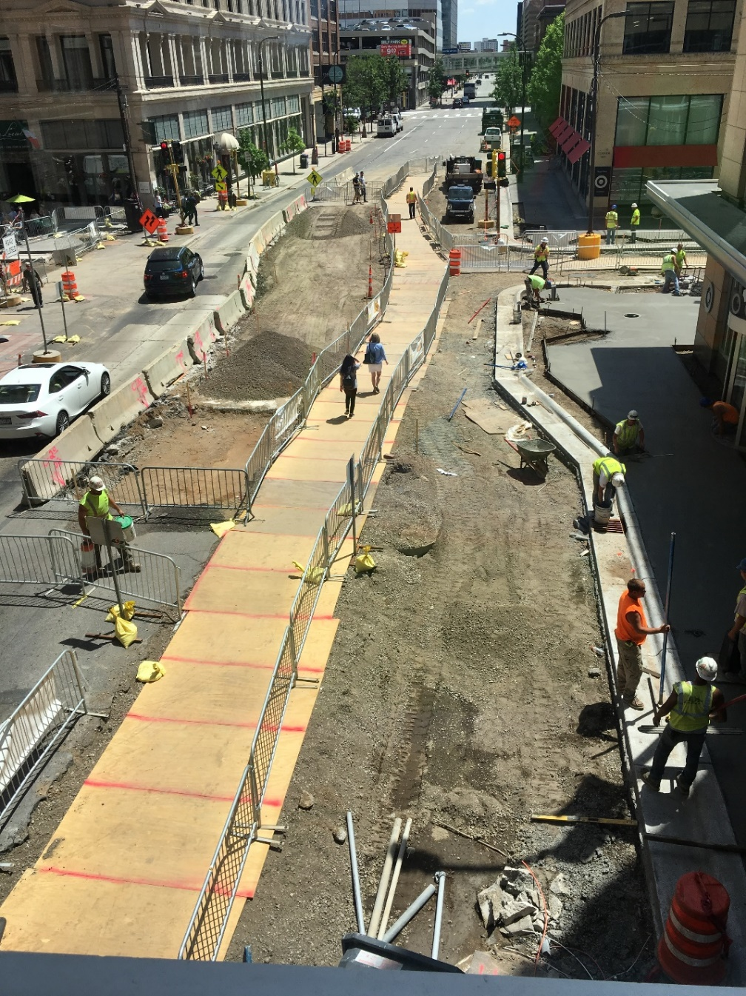
Looking Ahead – Spring 2024 Roadway Construction

Slide 17
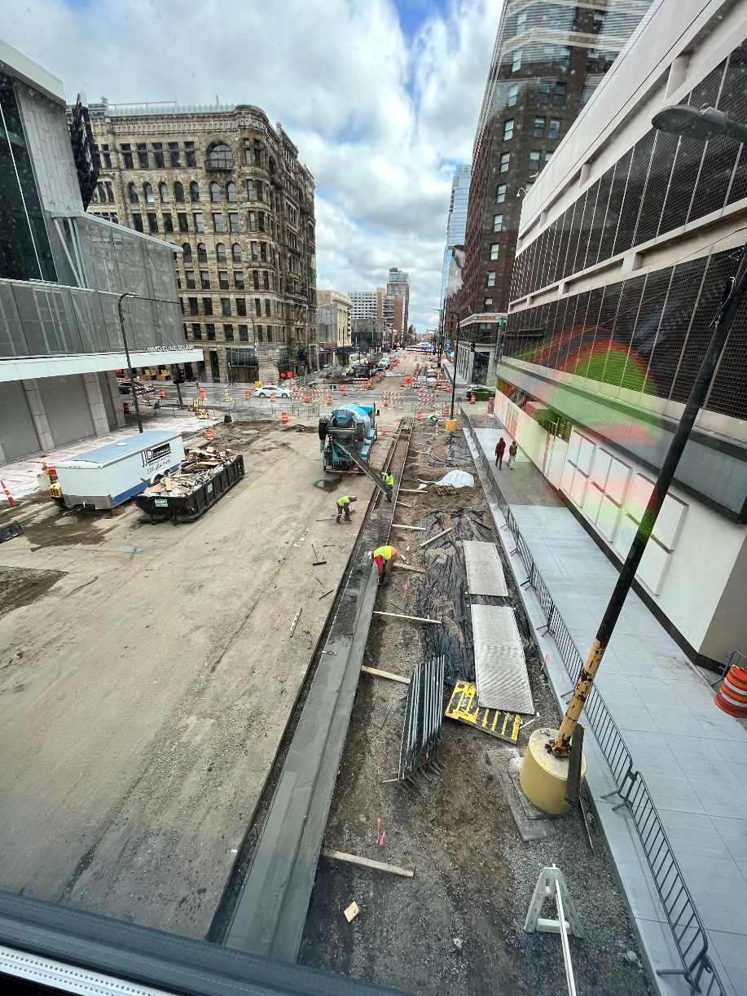
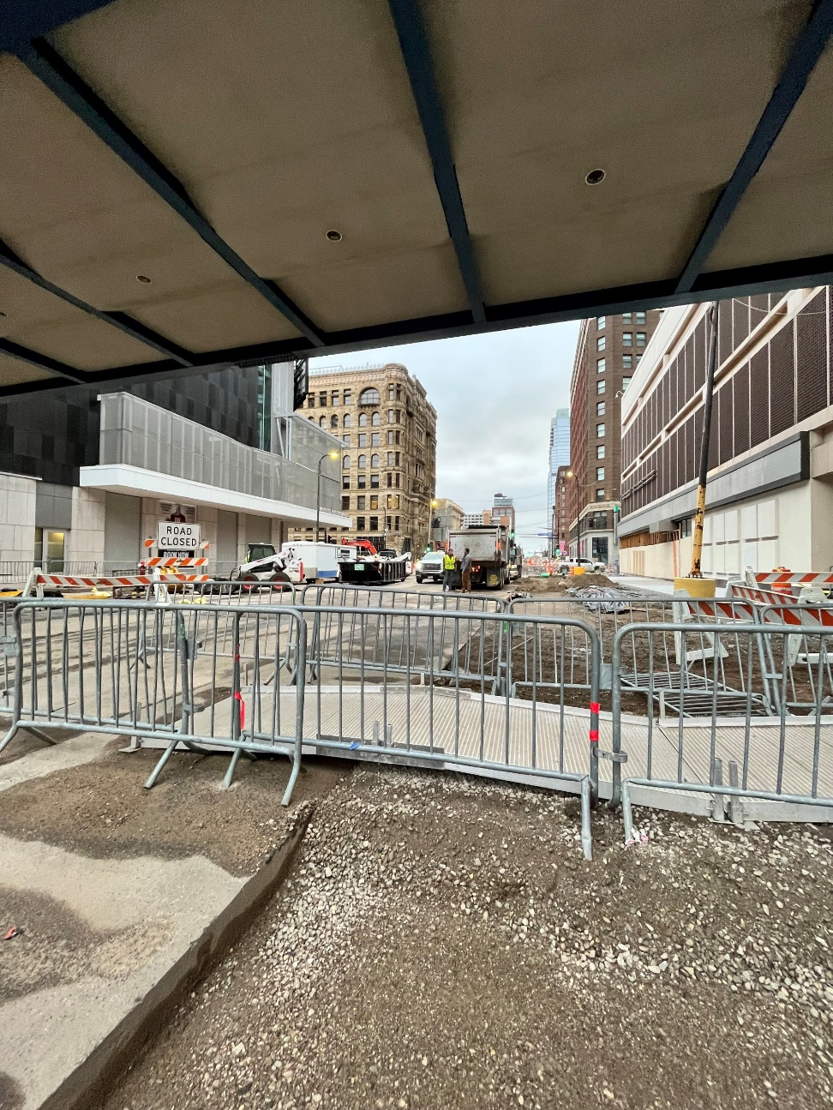
Looking Ahead – Spring 2024 Roadway Construction

Slide 18
Roadway PHASE 1 - 2024 = Lake St to W 26th St.
N
HENNEPIN AVENUE
W LAKE STREET
W 28TH STREET
W 26TH STREET
Downtown →

Slide 19
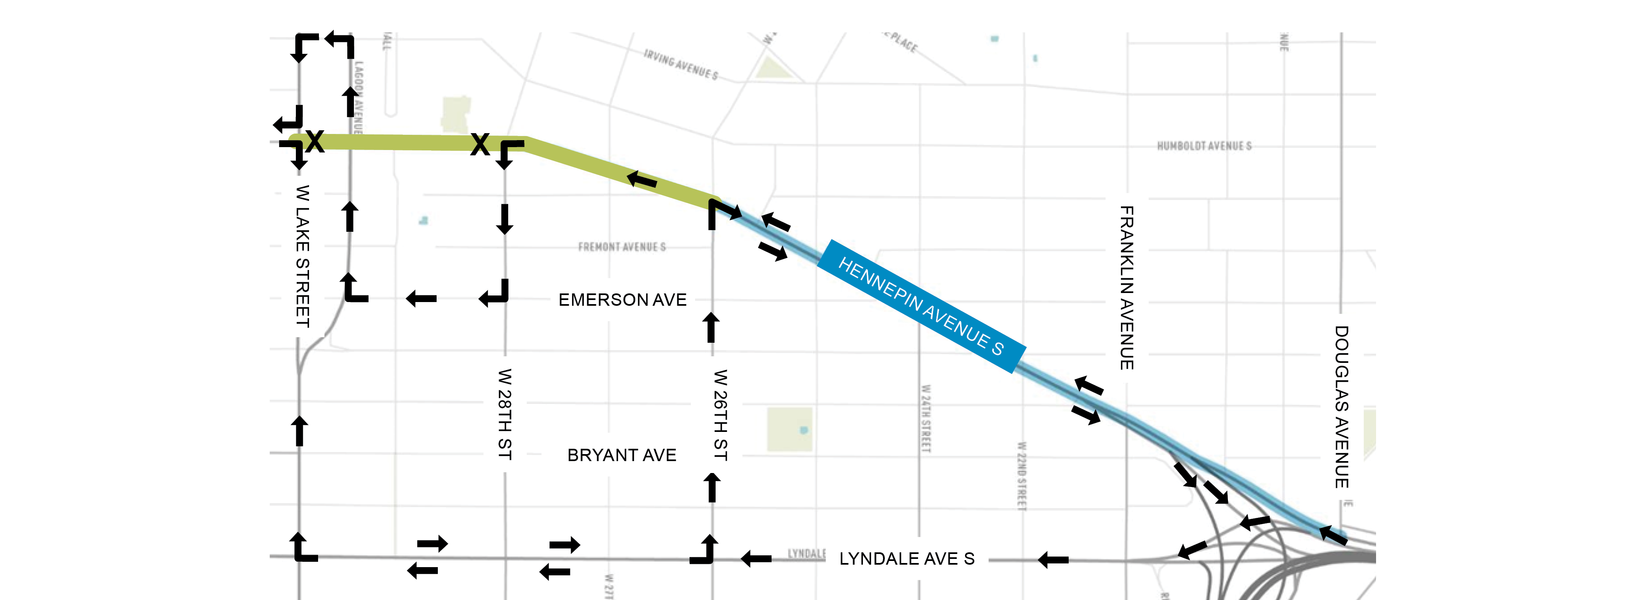
Detours: Phase 1 - 2024
N
** Work Zones, Lanes Configuration, and Access Subject to Change
I-94 INTERCHANGE
Downtown →

Slide 20
PHASE 2 – 2025 = W 26th St. to Douglas Ave
N
HENNEPIN AVENUE
FRANKLIN AVENUE
DOUGLAS AVENUE
W 26TH STREET
Downtown →

Slide 21
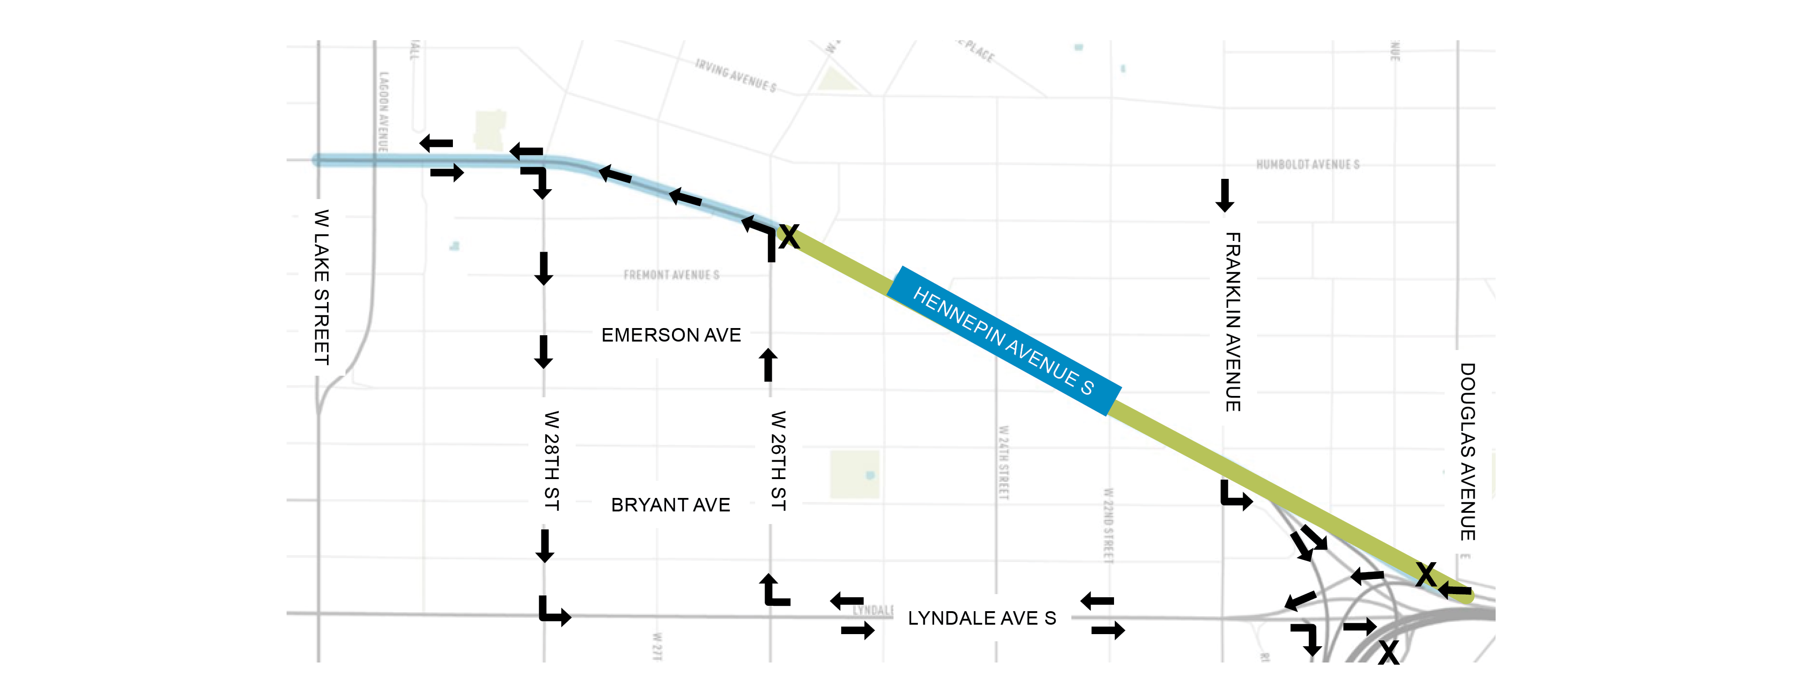
Detours: Phase 2 - 2025
N
** Work Zones, Lanes Configuration, and Access Subject to Change
I-94 INTERCHANGE
Downtown →

Slide 22
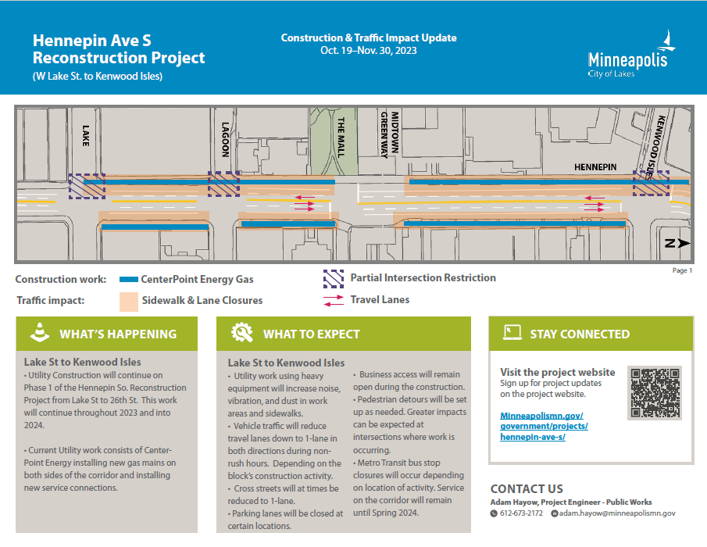
Stakeholder Communications
Month Updates Now until April 2024
2024 Weekly Email Updates
Weekly Friday Morning Stakeholder Mtgs
One-on-one Site Mtgs
Website
  www.minneapolismn.gov/government/projects/hennepin-ave-s/

Slide 23
Stay Connected
Questions & Answers
Project Website
  www.minneapolismn.gov/government/projects/hennepin-ave-s/
Road Closures
  Road Closures Map - City of Minneapolis (minneapolismn.gov)
CenterPoint Energy
  Minneapolis - Uptown (centerpointenergy.com)
  Hennepin Ave. closed (Lake St. to 31st St.) until Oct. 17 (govdelivery.com)

